Slide 1
Better Training for Safer Food Initiative
ASF in wild boar: practical management
Tomasz Podgórski
BTSF
This presentation is delivered under contract with the Consumers, Health, Agriculture and Food Executive Agency (http://ec.europa.eu/chafea). The content of this presentation is the sole responsibility of Opera S.u.r.l., the Istituto Zooprofilattico Sperimentale Lombardia e Emilia Romagna and the State Food and Veterinary Service of Latvia and it can in no way be taken to reflect the views of the Consumers, Health, Agriculture and Food Executive Agency or any other body of the European Union. The Consumers, Health, Agriculture and Food Executive Agency or any other body of the European Union will not be responsible under any circumstances for the contents of communication items prepared by the contractors.

Slide 2
Wild boar - surveillance
Wildlife surveillance mostly linked to hunting;
Sampling rather irregular;
Hunting seasonally limited;
Rarely adequate number of samples collected;
Mostly serological tests performed – only retrospective analysis.

Slide 3
Expert groups
maintain the expertise needed to assist the competent authority in ensuring disease preparedness;
shall assist the competent authority at least in:
(a) the epidemiological enquiry;
(b) sampling, testing and interpretation of results of laboratory tests;
(c) establishment of disease control measures.

Slide 4
Expert group assistance in a case of ASF in wild boars
studying the epidemiological situation and defining an infected area,
establishing appropriate measures to be applied in the infected area; these measures may include suspension of hunting and a ban in feeding wild animals,
drawing up the eradication plan,
carrying out checks to verify the effectiveness of the measures adopted to eradicate African swine fever from the infected area.

Slide 5
Infected area – how to define?
The historical and current geographical distribution of the infection;
Epidemiological investigations;
Wild boar home range, geographical distribution;
Landscape structure;
All the suitable wild boar habitat in geographical continuity;
Borders defined by artificial or natural barriers;
Not less than 200 km2:
It is possible to see the infection after several months;
It is a reasonable wild boar management unit;
According to the average wild boar densities it is possible to sample with appropriate intensities.
Easy to identify.

Slide 6
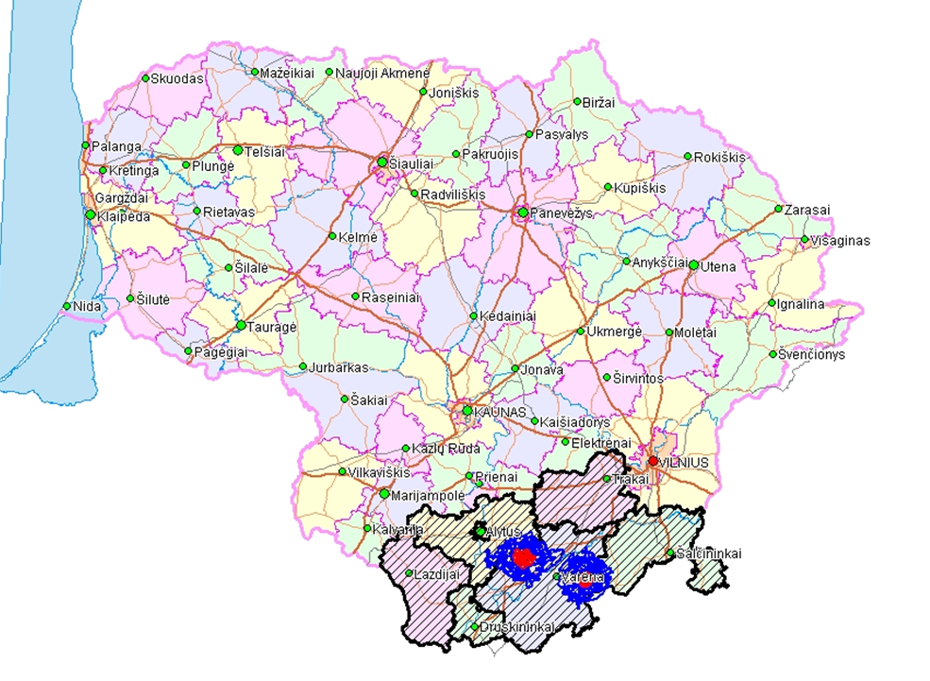
Demarcation of the infected area
Large enough for proper management;
Borders defined by administrative units or hunting ground units;

Slide 7
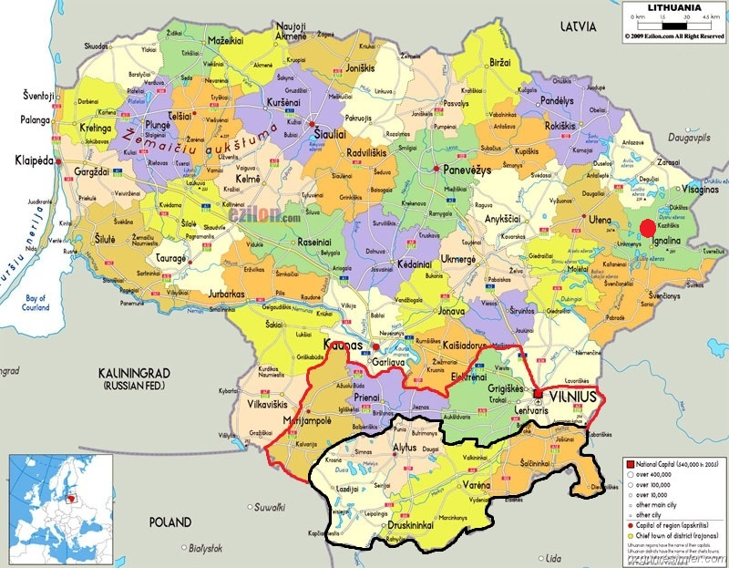
Area at risk
In 01/2014
Infected area
In 01/2014

Slide 8
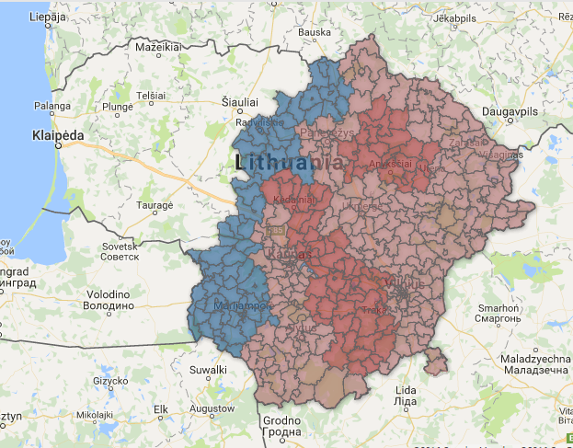
Area at risk in 2016
Infected area
in 2016

Slide 9
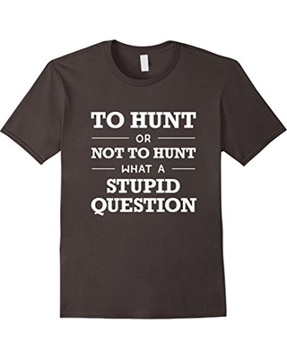
To hunt or not to hunt?
Hunting wild boars could appear a simple and direct way to manage the number of susceptible animals in order to facilitate the control and the eradication of ASF.
However, hunting pressure may be counterproductive, since it may increase the size of the home-range of wild boar meta populations, facilitating contacts between meta-populations, and promoting long distance movements of individual animals.

Slide 10
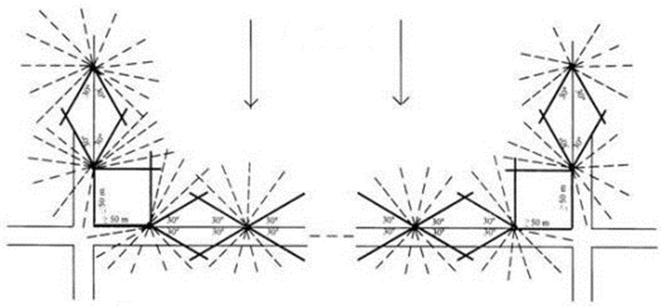
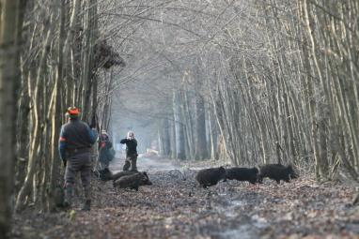
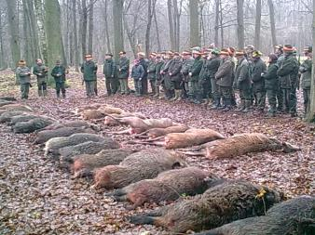
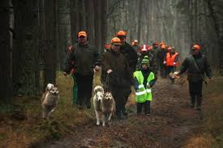
Hunting methods
Driven hunt
Notes:
Pros (efficient) and cons (disturbance and environmental contamination)

Slide 11
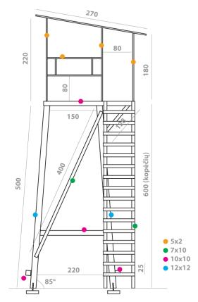
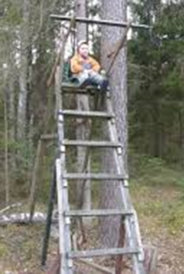
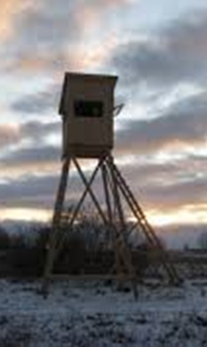
Hunting methods
Solo hunt
Notes:
Not disturbant, can be much more selective (e.g targeting females)

Slide 12
Surveillance in the infected area
Due to the characteristics of the disease, obvious clinical signs and high fatality rate, passive surveillance based on investigation of wild boar found sick or dead plays a pivotal role in the early detection of ASF!
In addition, given that a certain proportion of wild boar may also survive the infection, active surveillance of shot animals may also provide very valuable data on the evolution of the disease and guidance on the assessment of the effectiveness of the disease control measures adopted in the area.

Slide 13
Surveillance in the infected area
The size of the target population to be sampled should be previously defined in order to establish the number of samples to be taken.
Sample size must be established as a function of the estimated number of living animals and not as a function of the number of animals shot.
If data on population distribution, density and size are not available, the geographical area in which the sampling to be carried out must be identified taking into account the continuous presence of wild boars and the presence of natural or artificial barriers that will efficiently prevent large and continuous movement of the animals.
It is recommended to identify sampling geographical units of about 200 km2 , with a feral pigs population of about 400 to 1000 heads.
The minimum number of feral pigs to be sampled within each defined sampling unit must allow for the detection of 5 % prevalence with 95 % confidence. For this purpose at least 56 animals must be sampled in each unit within a hunting season.

Slide 14
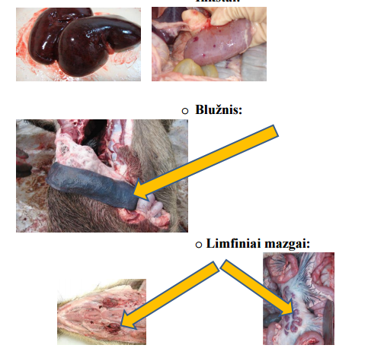
Surveillance in the infected area
Places at specified high risk for the introduction and spread of ASF, such as those where wild boars are gathered by the hunters and inspected, should be kept under strict supervision of veterinarians and personnel well-trained in recognizing the signs and lesions caused by the disease and on the measures to be adopted to avoid its spread.

Slide 15
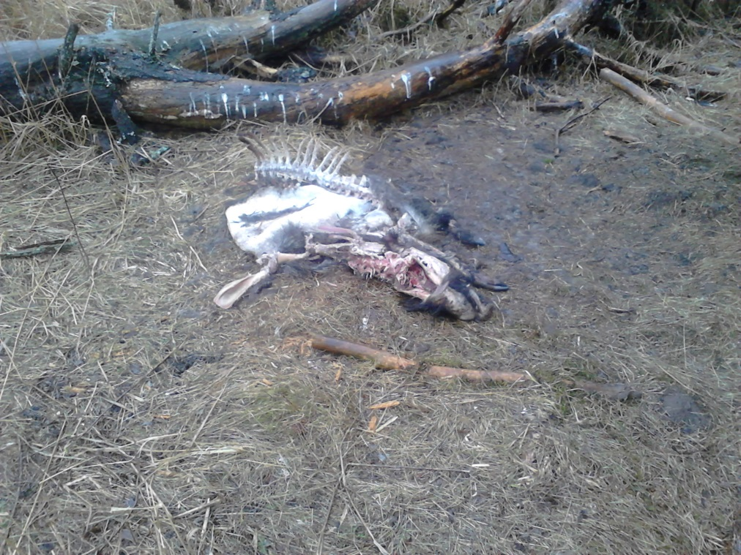
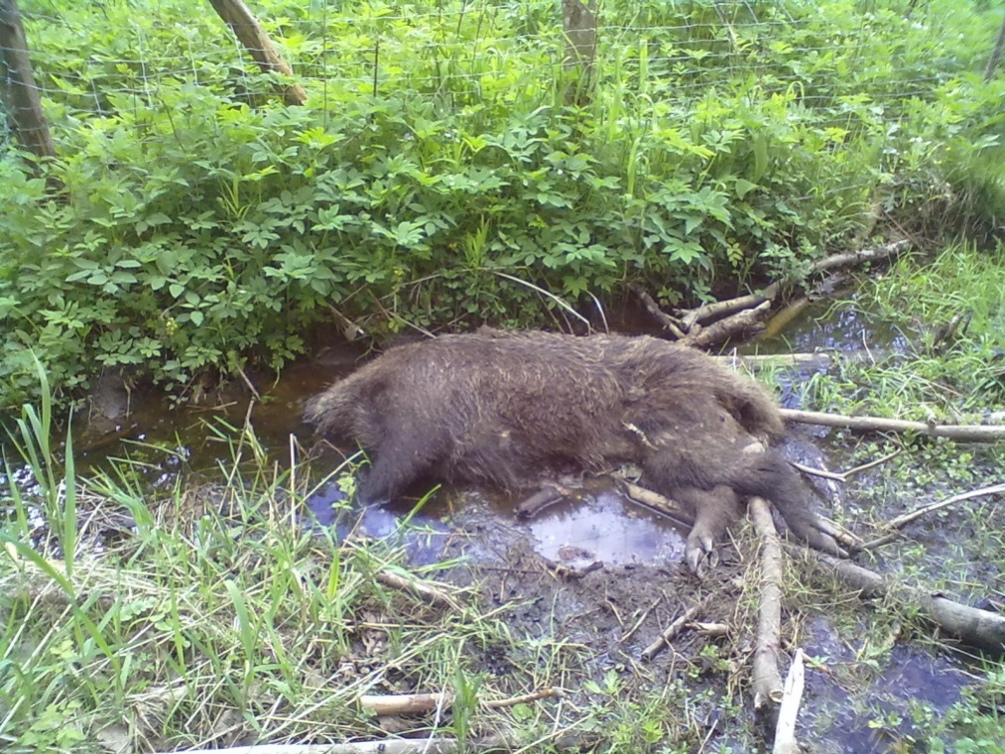
Disposal of carcasses
Carcasses of all domestic and wild boars found dead in the infected areas shall be processed under official supervision and tested!

Slide 16
SANCO/7112/2015 – Principles and criteria for geographically defining ASF regionalization
the infection continued to spread slowly through the wild boar populations;
the spread of the disease in the wild boar populations seems to be independent of the density of the wild boar populations;
the introduction and transboundary spread of ASF occurs through wild boar sub-populations;
short-distance spread of ASF up to 50 km/year have been observed in the wild boar population which can be attributed to direct contact between infected animals, whereas sudden long distance spread obviously cannot be explained by direct contact between wild boar alone and suggest the involvement of the human factor.

Slide 17
SANCO/7112/2015 – Principles and criteria for geographically defining ASF regionalization
The definition of the size and shape of any area should take into account at least the following factors:
a) geographical aspects linked to the location of the outbreaks/wild boar cases;
b) ecological factors (e.g. water ways, forests) and the existence of natural and artificial barriers;
c) presence and distribution of wild boar;
d) epidemiology of the disease;

Slide 18
SANCO/7112/2015 – Principles and criteria for geographically defining ASF regionalization
e) results of specific epidemiological studies;
f) historical experience gained on ASF spread;
g) administrative divisions, territorial continuity and enforceability of the control measures;
h) distribution of pig farms (non-commercial farms, commercial farms and outdoor farms) and the existence of protection and surveillance zones (if any);
i) hunting practices and other wildlife management considerations.

Slide 19
ASF Strategy for Eastern Part of the EU
Targeted hunting is encouraged in order to target adult and sub-adult females. Based on recent experience from some Member States, reaching a wild boar density of 0,5 wild boar/km² or lower is expected to reduce the spread of ASF.
The overall hunting bag should be balanced between male and females (50% each). Priority should be given to adult and sub-adult females.

Slide 20
ASF Strategy for Eastern Part of the EU
Starting from the border between part I and part II of Decision 2014/709/EU, in a strip in Part II at least 20 km wide, hunting should be conducted as such to avoid excessive movement of animals. The size of the areas can be reviewed based on the outcome of a risk analysis.
Continuous awareness campaigns should be foreseen for hunters for informing about the new strategy and the intended goals so to encourage the participation of hunters in the strategy.

Slide 21
Thank you for your kind attention!

Slide 22
This presentation is delivered under contract with the Consumers, Health, Agriculture and Food Executive Agency (http://ec.europa.eu/chafea). The content of this presentation is the sole responsibility of Opera S.u.r.l., the Istituto Zooprofilattico Sperimentale Lombardia e Emilia Romagna and the State Food and Veterinary Service of Latvia and it can in no way be taken to reflect the views of the Consumers, Health, Agriculture and Food Executive Agency or any other body of the European Union. The Consumers, Health, Agriculture and Food Executive Agency or any other body of the European Union will not be responsible under any circumstances for the contents of communication items prepared by the contractors.
Opera S.u.r.l.
Viale Parioli 96 - 00197 Roma - Italy
Tel +39 06 96042652 / +39 06 8080111
Fax +39 06 89280678
info@opera-italy.it; www.btsftraining.com; www.opera-italy.it
European Commission Consumers, Health, Agriculture and Food Executive Agency DRB A3/042 L-2920 Luxembourg

