Slide 1
Better Training for Safer Food Initiative
BTSF
Surveillance of ASF in wild boar
This presentation is delivered under contract with the Consumers, Health, Agriculture and Food Executive Agency (http://ec.europa.eu/chafea). The content of this presentation is the sole responsibility of Opera S.r.l. and VetEffecT Consultancy & Recruiting BV and it can in no way be taken to reflect the views of the Consumers, Health, Agriculture and Food Executive Agency or any other body of the European Union. The Consumers, Health, Agriculture and Food Executive Agency or any other body of the European Union will not be responsible under any circumstances for the contents of communication items prepared by the contractors

Slide 2
Overview
Aim of surveillance
Definitions
High risk periods during an epidemic
Wildlife
Surveillance in practice
Critical points
ASF example
A final message

Slide 3
Early detection and control of animal diseases Has the infection been introduced? Determine trends over time Is the prevalence of the infection decreasing or increasing? Assess whether animal health goals and targets are being reached Is the applied control/eradication strategy working?
Aim of surveillance

Slide 4
Disease surveillance in animal health is the on-going systematic collection, analysis and interpretation of data and the dissemination of information to those who need to know in order to take action Monitoring may share common features with surveillance programs with the main difference being that monitoring activities do not require a pre-specified action to be taken although significant changes are likely to lead action Surveys usually directed to identify a specific problem (for instance a preliminary survey carried out to have an estimate of prevalence before implementing a surveillance system for a specific disease) and surveys are usually limited in time. Surveys may be one component of a surveillance system as a whole
Broad “official” definitions

Slide 5
Passive (reactive) | Active (proactive)
Stakeholders report to Veterinary Service some “problem” Individual animals belonging to the “Suspect case definition” are reported and - eventually - tested | Veterinarians collect animal health data using a defined protocol to perform actions that are scheduled in advance (sampling, tests etc.) A population or a part of it (risk based) is actively investigated to detect an infection

Slide 6
Passive or active: which is better?
Passive is better when | Active is better when
An official “suspect case” definition is available and well known among stakeholders Evident Clinical Symptoms High lethality rate High animal owners awareness High Veterinary Service awareness | Clinical symptoms are not evident, episodic or short lasting Low/null lethality rate Low animal owners awareness

Slide 7
High Risk Periods
FIRST | SECOND
The period between the introduction of an infection into a Country and the first detection of the infection How much time we need to detect the infection? | The period between the first animal has been detected as infected and the establishment of measures to prevent virus spreading How much time we need to put in place control measures ?
The length of the 1st HRP depends on: the efficacy and efficiency of the surveillance scheme in place | Outbreak management
Surveillance strategy

Slide 8
HRPs duration
The success of a disease control policy is related to the capacity to limit the spread of the infection during the two High Risk Periods of an epidemic:
Rapid identification of the virus (agent): early detection
Increased bio-security and hygienic standards
Prompt enforcement of appropriate control measures (reduction of the wild boar population)

Slide 9
Efficiency of a surveillance system
The efficiency of a surveillance system is modulated according to the characteristics of:
Disease: lethality, spread, clinical signs
Susceptible host population: species, geographical distribution, size, breeding system; biosecurity etc.
and
Risk of introduction: risk assessment

Slide 10
Surveillance in wildlife
Role played by wildlife in the epidemiology of infection: if epidemiological reservoir of ASF virus
Epidemiological unit: the wildlife metapopulation that lives in a continuous geographic distribution delimited by natural or artificial barriers
Suspect case definition: rarely clinical signs are seen, death is the obvious symptom (low lethal diseases)
Efficacy of the passive surveillance: difficult to assess: how many dead individuals are retrieved in peace time?
Sampling unit: which is correct sampling unit in order to avoid sampling dilution (low detection probability) or oversampling?
Sample collection: how to collect sample?
Timing: seasonal hunting, catching, virology vs. serology

Slide 11
Surveillance in practice
Highest probability to detect the introduction of infection in a free area (early detection)
Highest precision in measuring epidemiological parameters (i.e. prevalence, n. of seropositive animals etc.)
Sustainable from both implementation and economical terms
Have a practical approach (actions are foreseen)

Slide 12
Which animals have to be tested ? The suspect case definition
Does not define the clinical signs of the infection we are interested on
Does not define the population at risk
It defines which are the characteristics of the animals that will be actively selected by the surveillance program (investigated, inspected, tested etc.)

Slide 13
Detection of ASF using two suspect case definitions
A) All individuals shot, found dead => broad suspect case definition
B) All individuals shot showing clinical sign of the diseases => narrow suspect case definition
A BROAD SUSPECT CASE DEFINITION: high sensitivity of the surveillance system, but too many laboratory investigations, material for field sampling, travels to the lab etc.
A NARROW SUSPECT CASE DEFINITION: low surveillance sensitivity since wild boars that could show clinical signs are unlikely to be sighted
Do we expect the same number of investigated cases?
Do we expect the same number of positive cases?

Slide 14
Passive surveillance: critical points I
Suspect case definition:
broad definition will increase the sensibility of the surveillance (many false positive cases) whereas narrow definition will reduce the number of false positive cases but might enhance the number false negative cases and thus leaving undetected for some time the infection in the area.
The suspect case definition could be adjusted according to the (perceived or assessed) risk of the area:
Low risk => narrow case definition (undetected positive cases)
High risk => broader case definition (many negative cases investigated)

Slide 15
Passive surveillance: critical points II
Communication chain: passive surveillance is based on reporting, hence a person willing to report must know to whom to report and how
To whom it should be reported the finding of a dead wild boar in the forest?
Awareness and acceptance: is the most important step of any passive surveillance. I.e. nobody will report what is unknown, or a disease for which a stamp out policy without compensation will be applied.
The detection of ASF in wild boars poses several restriction when hunting: are hunters willing to participate?

Slide 16
Passive surveillance: critical points III
Evaluation of the passive surveillance efficiency: no reports does not mean no cases!
The number of suspected cases to be investigated has to be estimated in advance, same figures should be used to evaluate the efficacy of the surveillance in place;
In peace time, how many dead wild boars should be found in at risk areas?
Duration: it is always difficult to maintain a high level of passive surveillance for any disease absent for a long period
When France, Hungary, UK should put in place a efficient surveillance system for the early detection of ASF in wild boars and how long it should run?

Slide 17
Active surveillance: critical points
Epidemiological unit: the area of interest for which surveillance is addressed.
(For the purposes of ASF in wild boar, this is equivalent to the Infected Area, as referred to in Article 16(3)b of Council Directive 2002/60/EC)
Sampling unit: the basic unit from which sampling intensity is calculated and samples collected (forest, administrative units etc.).
(SANCO working document 7138/2013 on ASF surveillance in wild boar recommends areas of 200km² with a wild boar population of 400-1000 head)
Sample size: expected prevalence adjusted according to literature data and feasibility/sustainability. Antigen vs. antibodies detection
Sampling rate: does the length of time that I need to collect the expected n. of samples affect the surveillance results?

Slide 18
Active surveillance in infected areas
The virus is present;
Quantification of the spread of the virus (prevalence/incidence)
Virological and or serological tests
Sample collection: hunters/veterinarians
Risk of further spread of infection: appropriate management of hunting grounds, handling of shot wild boars when transported in private cars; hygienic standard of the dressing areas, storage of carcasses while waiting for the results of the tests; positive carcasses disposal, etc.

Slide 19
ASF surveillance in wild boar Field example
Aim: a) early detection b) evolution of the infection

Slide 20
The 5%/95% strategy What does it means?
At least one (1) wild boar will be detected positive if at least 5% of the animals in the sampled population are positive
If “only” 3-4% of the animals are infected NO POSITIVE WILD BOAR will be detected; Currently: ASF prevalence in endemic areas is 3-4%!
In a population of 1000 wild boar, the detection of 1 positive wild boar out of 50 positive animals, could be considered EARLY DETECTION?

Slide 21
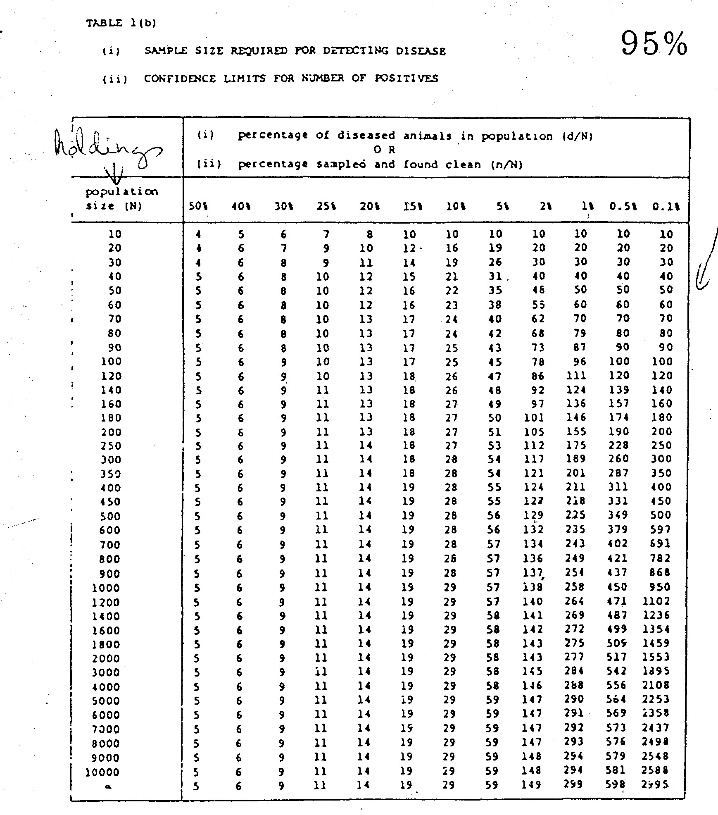
Animals
Prevalence

Slide 22
Animals
Prevalence

Slide 23
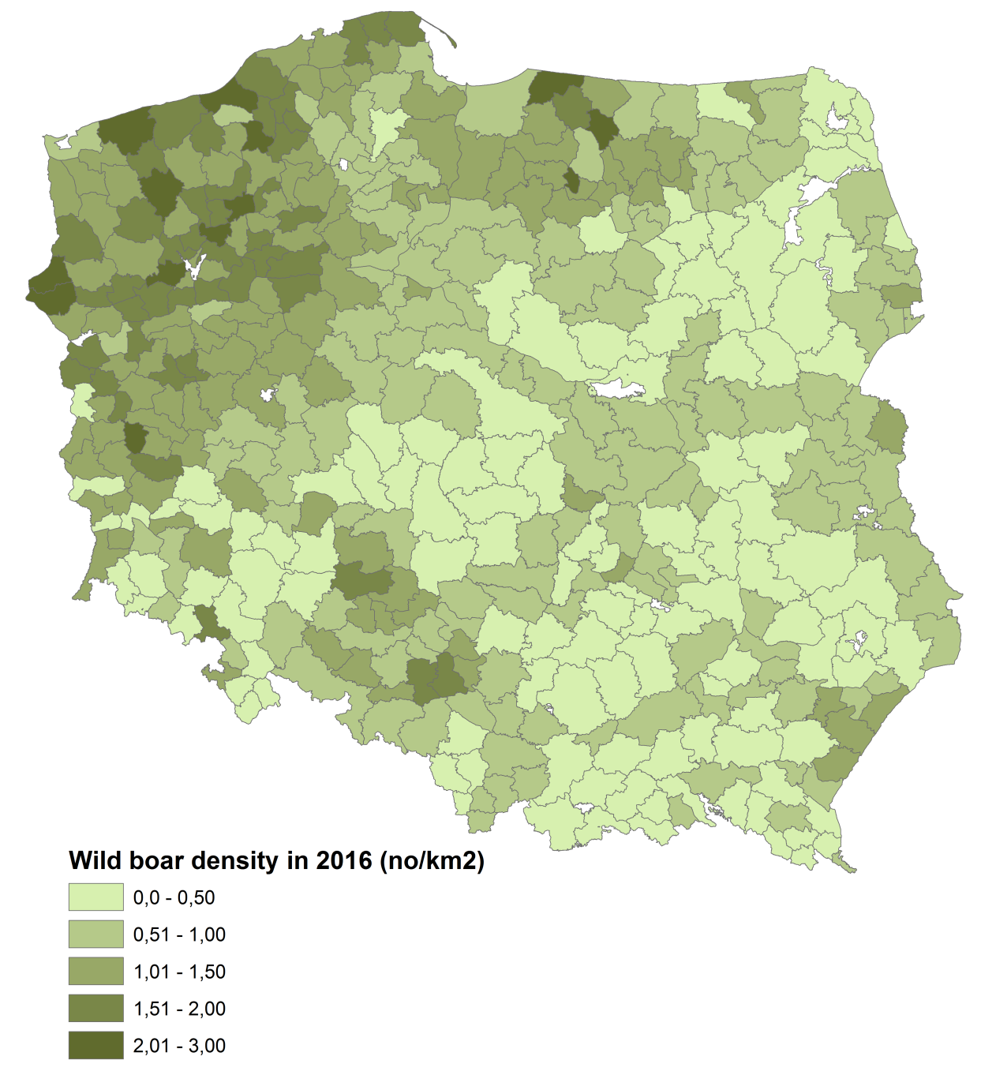
Poland: 264.000 wild boars
Wild boar population assumed
as INFINITE: 2900 samples for the entire Country
If 100 sampling areas having
With an average of 2600 animals:
1600x100=160.000
OK, you completed the sampling on January the 1st
..and if the virus will be introduced on January 2nd ?

Slide 24
The 5%/95% strategy sampling has to follow precise assumptions:
Set an expected prevalence according to the goal of sampling: EARLY DETECTION (0,1 – 0,2…..10%)
Animals have to belong to the same risk group (same probability to be positive; i.e. same hunting ground, same forest)
All animals have the same probability to be sampled (adult animals are shot?)
Sampling should be performed in a shorter time in respect to a single cycle of the infection (i.e. sampling during hunting season: 3 months)

Slide 25
Suspect case definition and ASF detection Broader case definition: all shot animals: N. 2733 39 detected cases (1,4%) 2694 negative investigations First case detected 25/06/2014 Narrow case definition: animals shot while showing clinical signs: N. 1 1 detected case (100%) Lost 226 cases No negative investigations Case detected 20/08/2014

Slide 26
Early detection of ASF in wild boars
Passive surveillance vs. active surveillance
 | LATVIA: Summary of wild boar data (June-December, 2014) within the infected areas (Part II and Part III)
 |  | Number of tested animals | Number of positive results
 | WB found dead | 227 | 178
 | WB hunted | 2733 | 39

Slide 27
Efficiency of passive vs active surveillance Virus detection in dead animals: 178/227 = 0,78 Virus detection in shot animals: 39/2733 = 0,014 detection in dead/detection in shot 0,78/0,014 = 55,7 The probability to detected a virus in dead animals is 55 times higher than in shot animals (55/(55+1)*100 = 98% 98 out of 100 are likely to be detected in dead wild boars

Slide 28
ASF prevalence estimation Found dead animals = 78% Shot animals = 1,4%
Which is the true period prevalence?
Is prevalence revealed by active or passive surveillance?
What can be compared among different countries?

Slide 29
Take at home message
Surveillance is a strategy shaped by appropriate techniques
Passive surveillance:
Irreplaceable in the early detection of almost all infectious diseases and in particular for ASF in wild boars
Active surveillance: useless for early detection in free and at risk areas
Active surveillance: in already infected areas.
Prevalence in hunted animals in infected areas is the sole epidemiological parameters that can be compared among different counties.

Slide 30
This presentation is delivered under contract with the Consumers, Health, Agriculture and Food Executive Agency (http://ec.europa.eu/chafea). The content of this presentation is the sole responsibility of Opera S.u.r.l., the Istituto Zooprofilattico Sperimentale Lombardia e Emilia Romagna and the State Food and Veterinary Service of Latvia and it can in no way be taken to reflect the views of the Consumers, Health, Agriculture and Food Executive Agency or any other body of the European Union. The Consumers, Health, Agriculture and Food Executive Agency or any other body of the European Union will not be responsible under any circumstances for the contents of communication items prepared by the contractors.
Opera S.u.r.l.
Viale Parioli 96 - 00197 Roma - Italy
Tel +39 06 96042652 / +39 06 8080111
Fax +39 06 89280678
info@opera-italy.it; www.btsftraining.com; www.opera-italy.it
European Commission Consumers, Health, Agriculture and Food Executive Agency DRB A3/042 L-2920 Luxembourg

