Slide 1

Better Training for Safer Food
Initiative
BTSF
Wild Boar ecology
Tomasz Podgórski
This presentation is delivered under contract with the Consumers, Health, Agriculture and Food Executive Agency (http://ec.europa.eu/chafea). The content of this presentation is the sole responsibility of Opera S.u.r.l., the Istituto Zooprofilattico Sperimentale Lombardia e Emilia Romagna and the State Food and Veterinary Service of Latvia and it can in no way be taken to reflect the views of the Consumers, Health, Agriculture and Food Executive Agency or any other body of the European Union. The Consumers, Health, Agriculture and Food Executive Agency or any other body of the European Union will not be responsible under any circumstances for the contents of communication items prepared by the contractors.

Slide 2
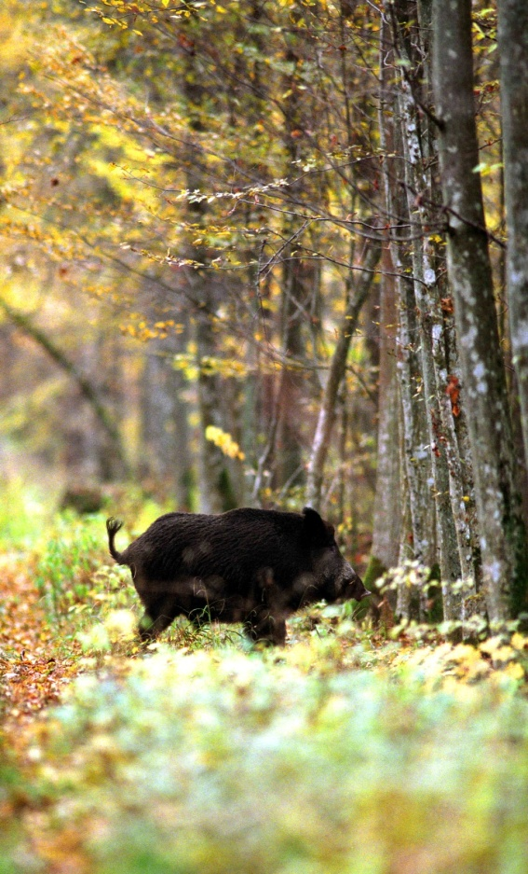
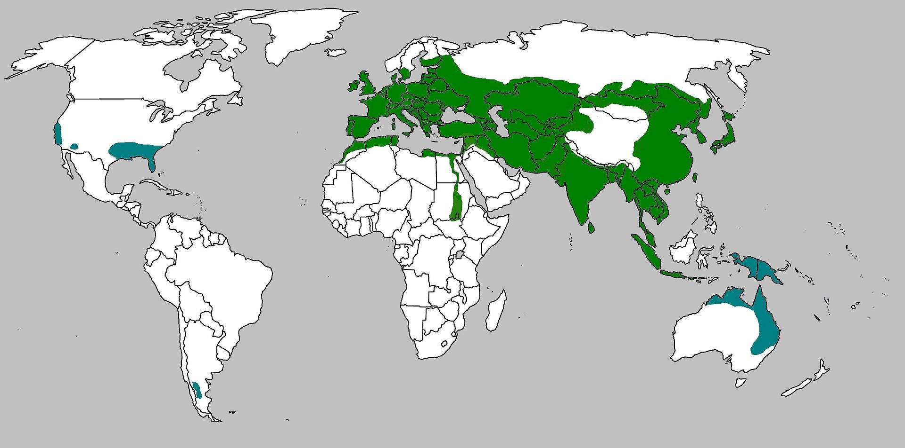
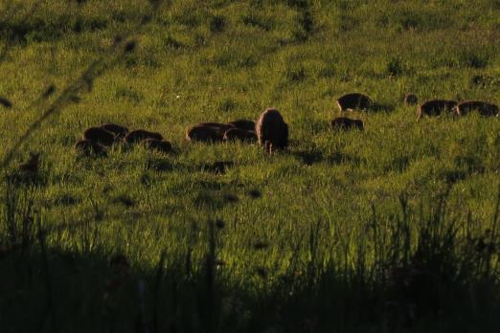
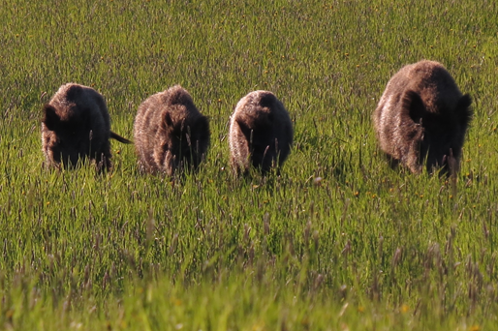
Wild Boar
The wild boar (Sus scrofa), also known as the wild swine or Eurasian wild pig, is a suid native to much of Eurasia, North Africa, and the Greater Sunda Islands.

Slide 3
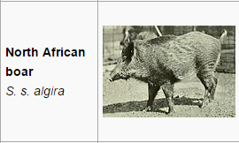
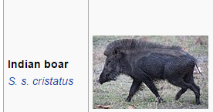
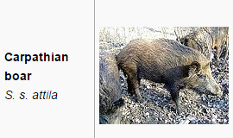
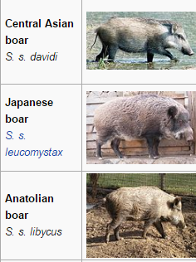
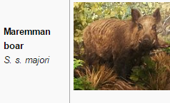
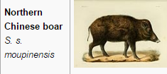
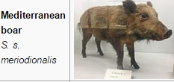
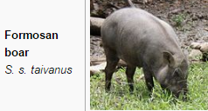
Wild boar

Slide 4
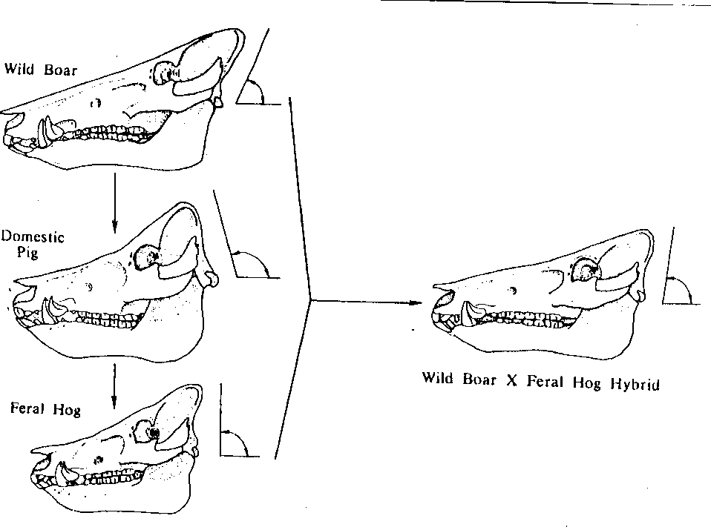
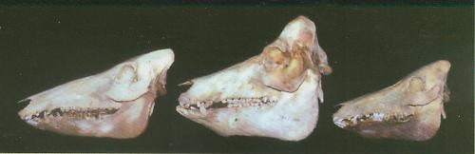
Wild Boar
Domestic
Feral
< 90º
> 90º
< 90º
Angle of Occipital wall
= 90º

Slide 5
Depth of Dorsal Profile

Slide 6
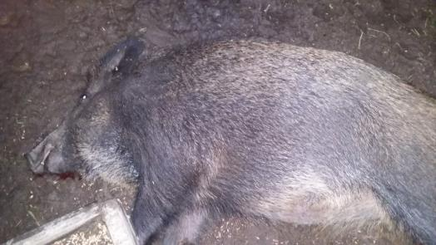
Central European boar
A medium-sized, dark to rusty-brown haired subspecies with long and relatively narrow lacrimal bones
Northern Spain, northern Italy, France, Germany, Benelux, Croatia, Belarus, Denmark (few), Lithuania, Poland, Czech Republic, Slovakia and possibly Albania

Slide 7
Ecology
The wild boar inhabits a diverse array of habitats from boreal taigas to deserts.
In mountainous regions, it can even occupy alpine zones, occurring up to 1,900 metres in the Carpathians, 2,600 metres in the Caucasus and up to 3,600-4,000 metres in the mountains in Central Asia and Kazakhstan.
The main habitats favored by boars in Europe are deciduous and mixed forests, with the most favorable areas consisting of forest composed of oak and beech enclosing marshes and meadows.
Notes:
Wild boar is now well adapted to agricultural landscape, can live most of the year in the corn field

Slide 8
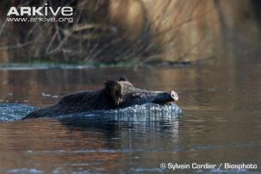
Ecology
In the Białowieża Forest, the animal's primary habitat consists of well developed, broad-leaved and mixed forests, along with marshy mixed forests, with coniferous forests and undergrowth's being of secondary importance.
Wild boar are known to be competent swimmers, capable of covering long distances. In 2013, one boar was reported to have completed the seven mile swim from France to Alderney in the Channel Islands. Due to concerns about disease it was shot and incinerated.

Slide 9
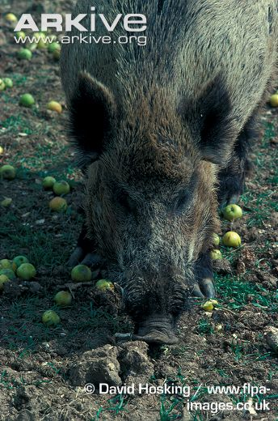
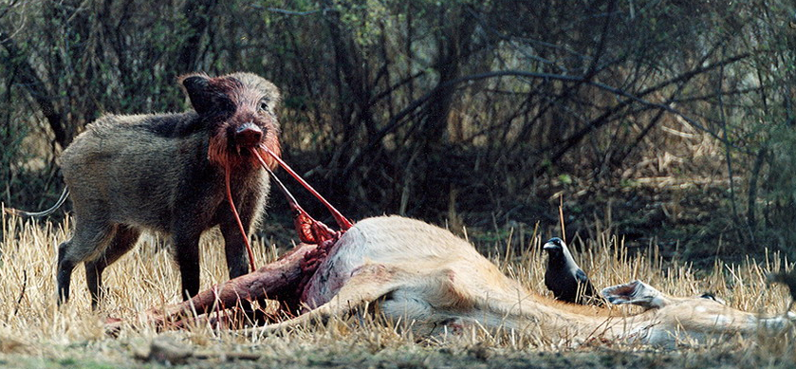
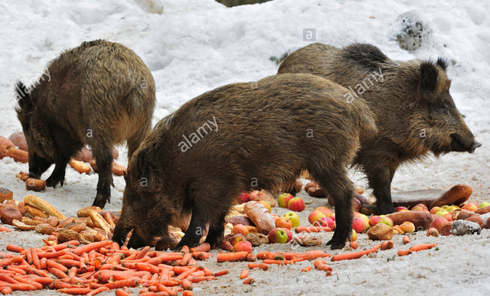
Diet
The wild boar is a highly versatile omnivore, whose diversity in choice of food rivals that of humans.
A 50 kg boar needs around 4,000-4,500 calories of food per day, though this required amount increases during winter and pregnancy, with the majority of its diet consisting of food items dug from the ground like underground plant material and burrowing animals.

Slide 10
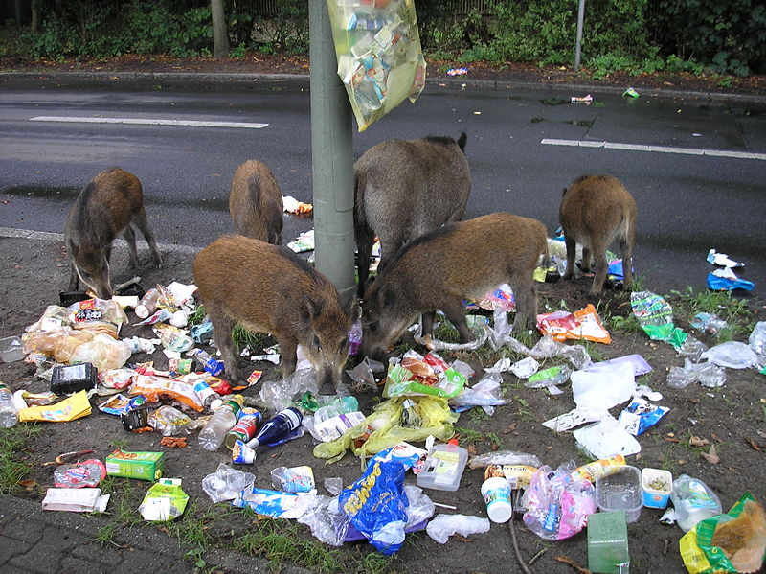
Notes:
Infected meat as a source of new infections – wild boar and pigs
2. Meat products in the garbage

Slide 11
How far can wild boar move?
Example of Bulgaria

Slide 12
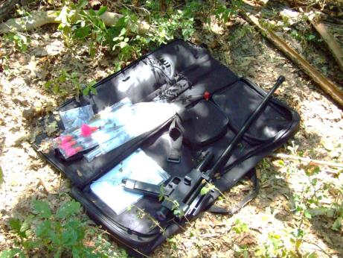
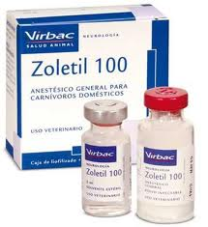
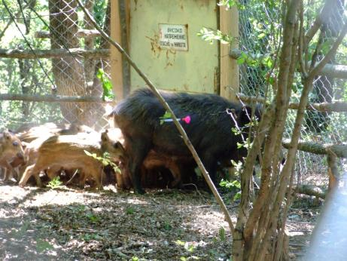
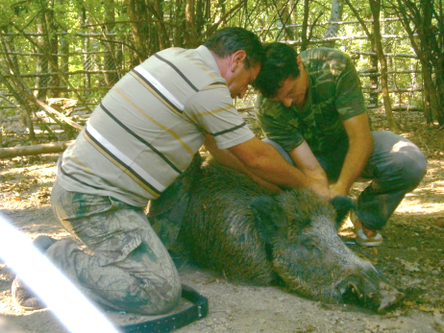

Slide 13
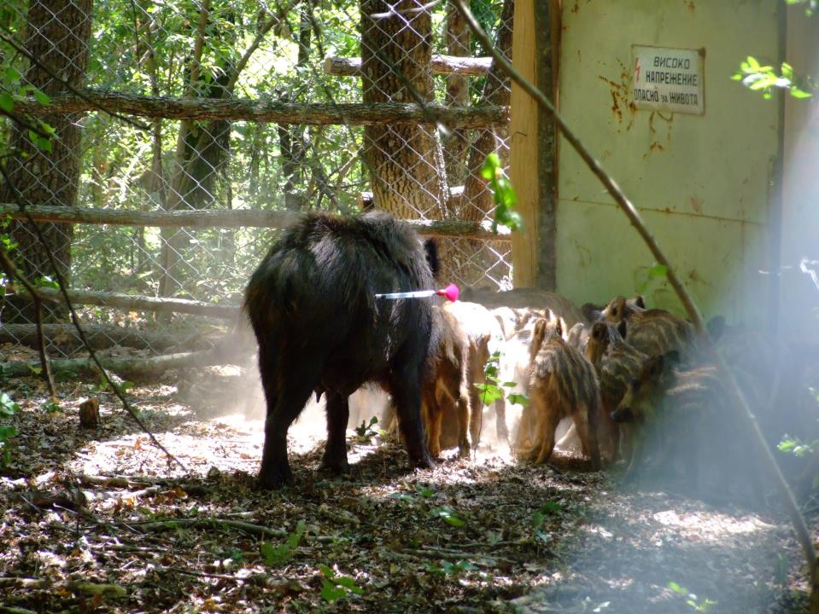

Slide 14
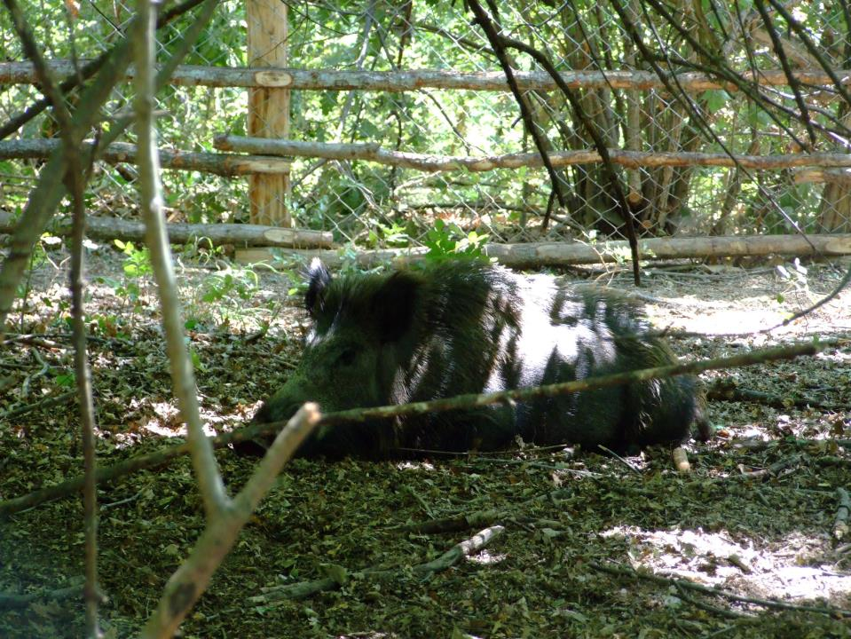

Slide 15
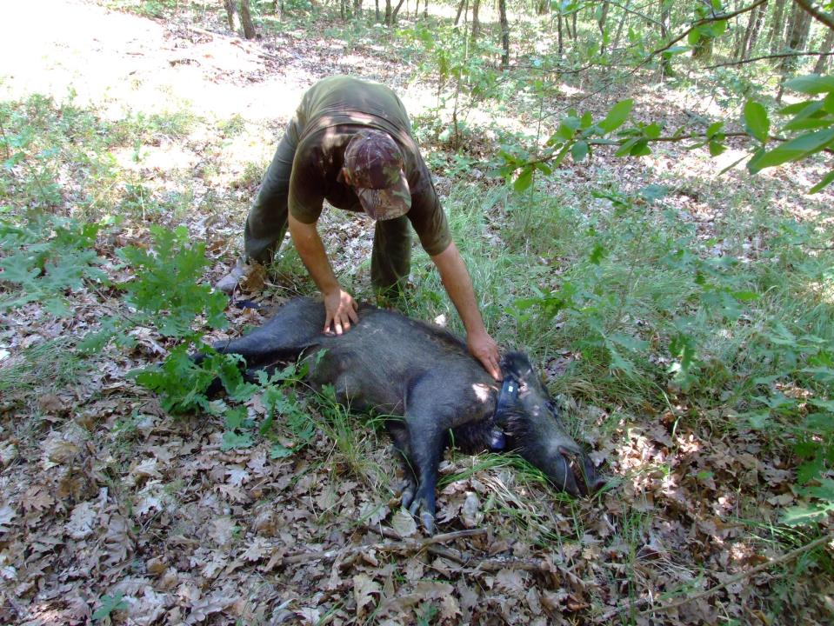

Slide 16
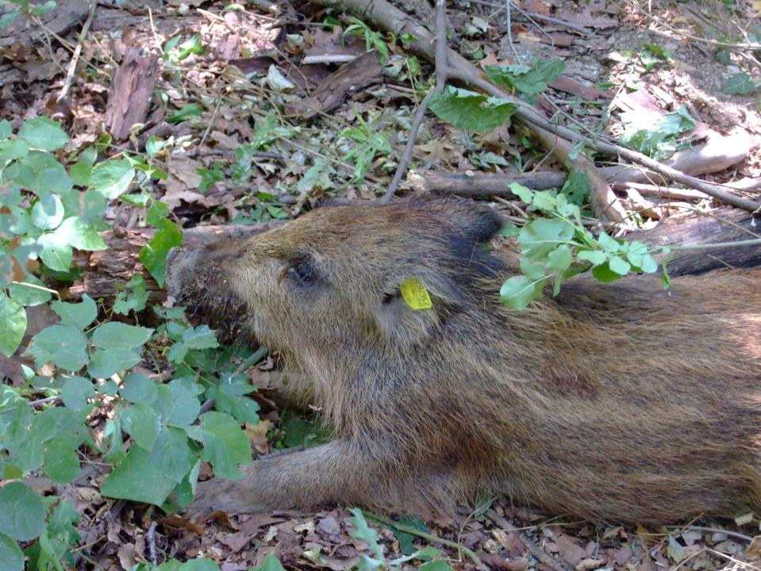

Slide 17
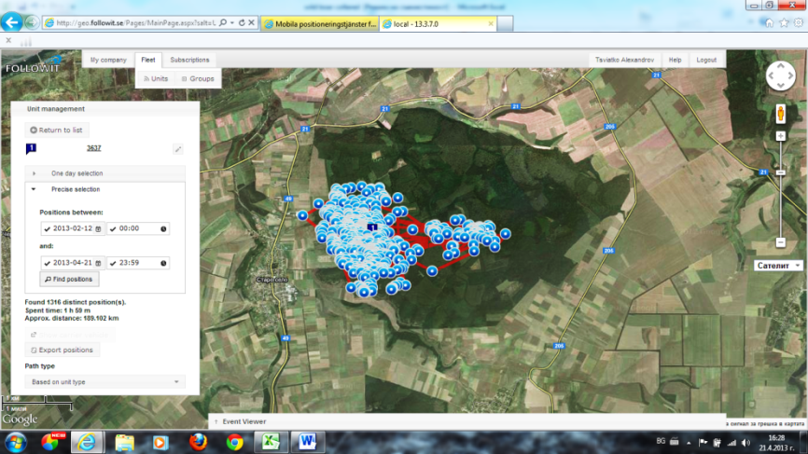
4 years old female
Tracked for 87 days
Positons received: 2149
Home range: 7 km²

Slide 18
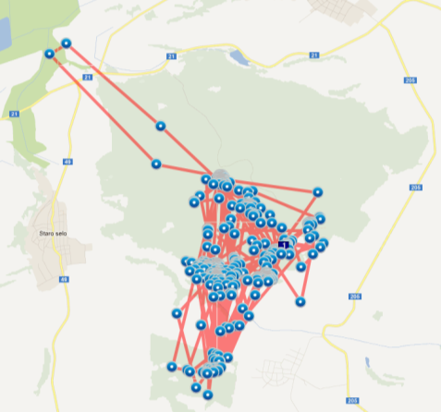
Movement
Escaping
hunting
WB normally small home ranges (4 - 20 km²);
Disrupted by only food availability or disturbance
Nighttime
Daytime
Future
farrowing
area
1 hour resolution movements of a tracked wild boar sow in Bulgaria

Slide 19
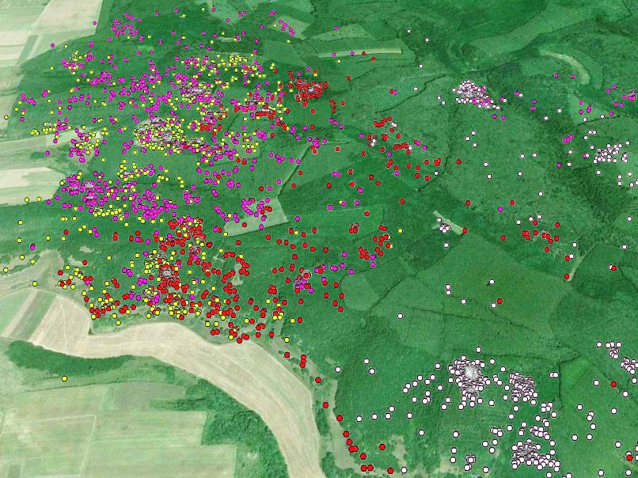
4 different groups of wild boar overlapping…..

Slide 20
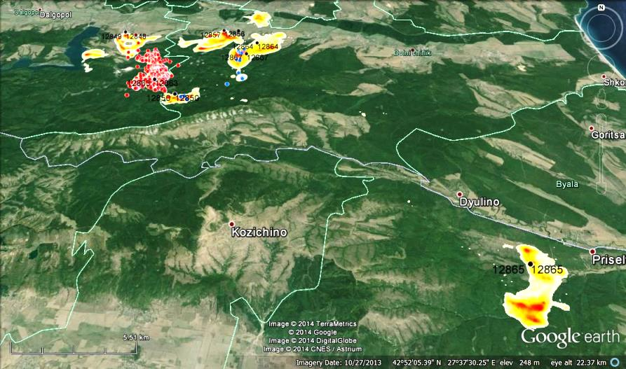
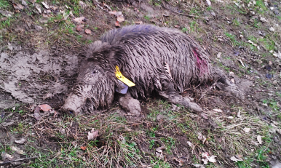

How far can wild boar go?
23 km
Notes:
This is escape movement from hunting, spent 3-months away from the home range

Slide 21
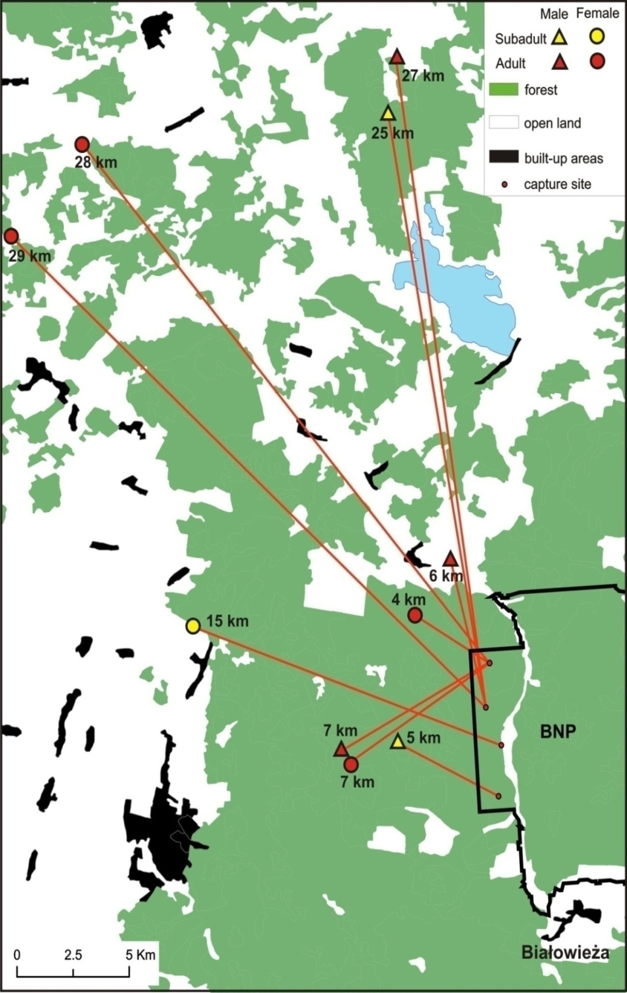
Long-distance movements in Białowieża Forest, NE Poland
Notes:
But most animals are sendentary and long distance movements <10%

Slide 22
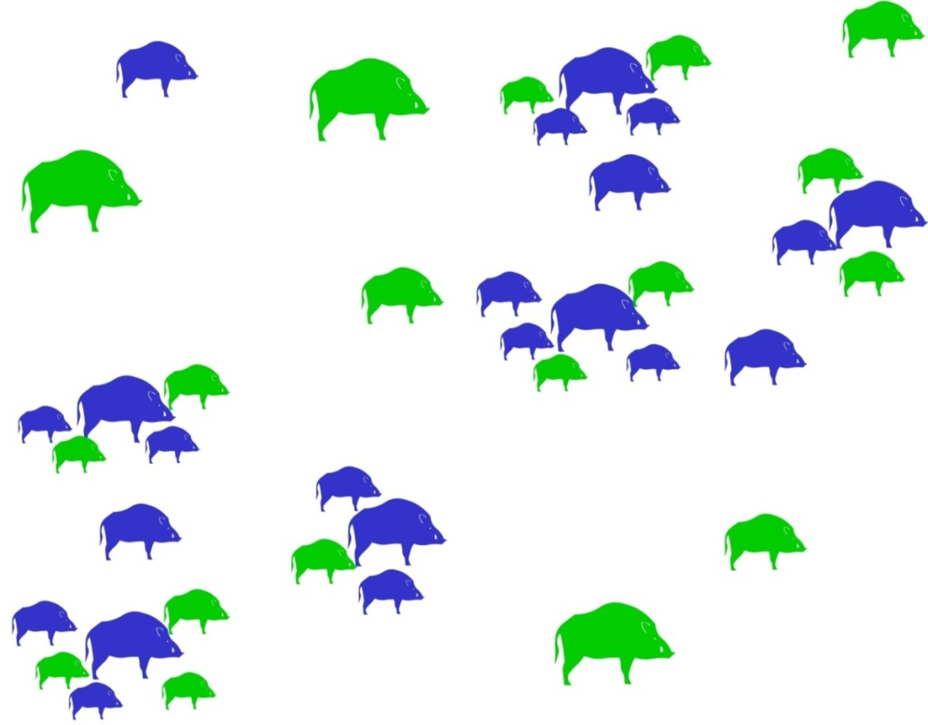
Wild boars – social behaviour
Boars are typically social animals, living in female-dominated sounders consisting of barren sows and mothers with young led by an old matriarch.
Male boars leave their sounder at the age of 8–15 months, while females either remain with their mothers or establish new territories nearby.
Sub adult males may live in loosely knit groups, while adult and elderly males tend to be solitary outside the breeding season.
♂
♀

Slide 23
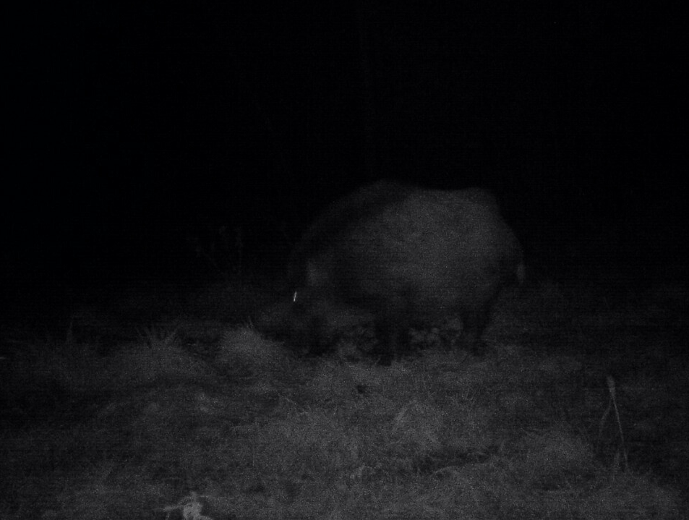
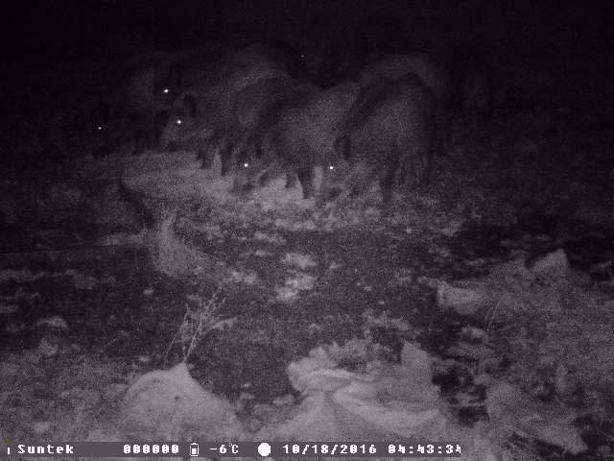
Behavior and Lifestyle
Wild Boar are nocturnal animals that only come out at night to forage for food.
Female’s are relatively sociable animals, inhabiting loose territories in groups known as sounders which can contain between 6 and 30 individuals.
Males however, are solitary for the majority of the year, with the exception of during the breeding season when they can be found in close proximity of both the sounders, and indeed other males. Male Wild Boar compete with one another by fighting for the chance to mate with a female.

Slide 24
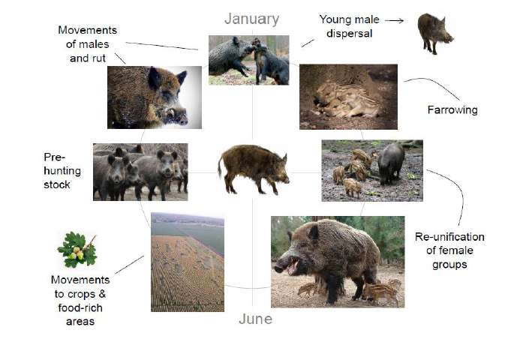
Notes:
Life-cycle

Slide 25
Diseases
Pseudorabies (Aujeszky’s disease)
Swine brucellosis
Influenza
Tularemia
West Nile virus
E. coli
Salmonella
Trichinosis
Streptococcus
Ticks, fleas, lice
Internal parasites
Toxoplasmosis and Trichinosis
Classical swine fever
African swine fever
PRRS
Anthrax
Foot and mouth disease
Porcine circovirus

Slide 26
African swine fever in wild boar – risk factors
Presence of the virus;
Size of the population;
Density of the population;
Size and density define the wild boar geographical distribution;
Age and gender of the infected wild boar population;
Type of hunting;
Period of the year during which the virus has been detected/introduced.

Slide 27
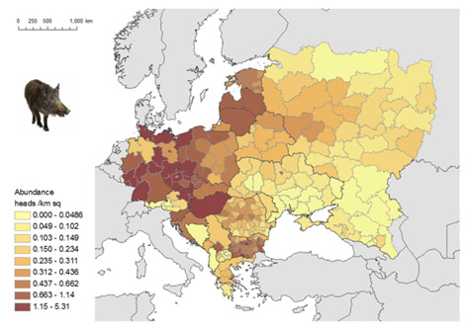
Wild boar density

Slide 28
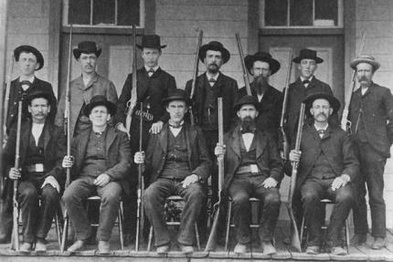
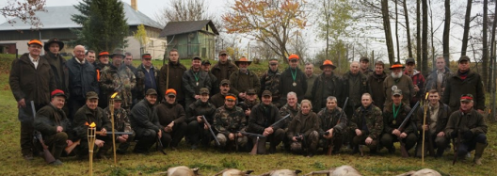
Can we control the hunters?
http://explorepahistory.com/displayimage.php?imgId=1-2-425

Slide 29
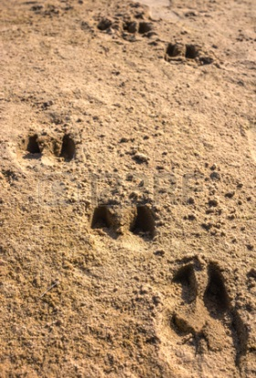
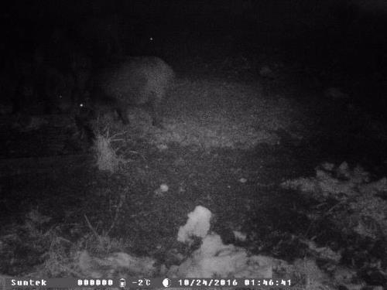
Wild boar density - how to estimate??

Slide 30
Estimation methods
Other estimation methods:
• indirect :
– snow traces calculation,
– faces groups calculation (moose's);
• direct :
– annual observation,
– counting in habitats,
– counting of animals entering open areas,
– aerial surveys (open areas),
– thermal counting (deer's and moose's).

Slide 31
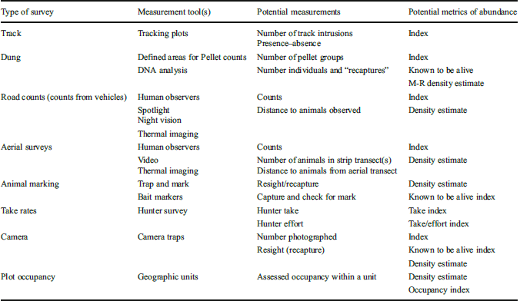
Wild boar density - how to estimate??
https://www.aphis.usda.gov/wildlife_damage/nwrc/publications/13pubs/engeman139.pdf

Slide 32

Wild boar density
Do we really know??
 | 2014 | 2015 | 2016
No of WB counted in Lithuania | 22325 | 27497 | 19699
No of hunted WB during a season (data presented 15/04) in Lithuania | 50172 | 48317 | 42188
Notes:
Estimates are done in late winter and counts only adults and last year offspring/yearlings, hence hunting bag is so much higher

Slide 33
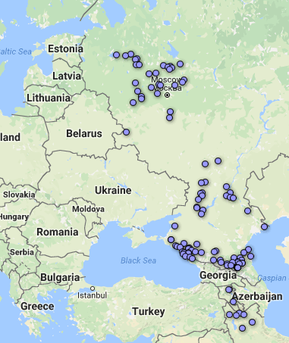
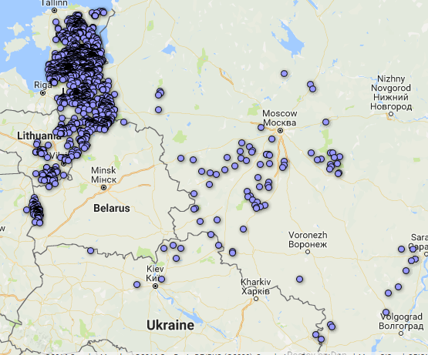
ASF distribution in wild boar since 2007
2007-2014
2014-2016

Slide 34
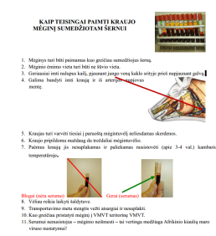
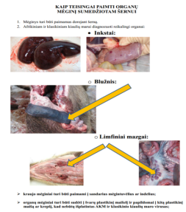
Continuous awareness campaigns should be foreseen for hunters for informing about the new strategy and the intended goals so to encourage the participation of hunters in the strategy.

Slide 35
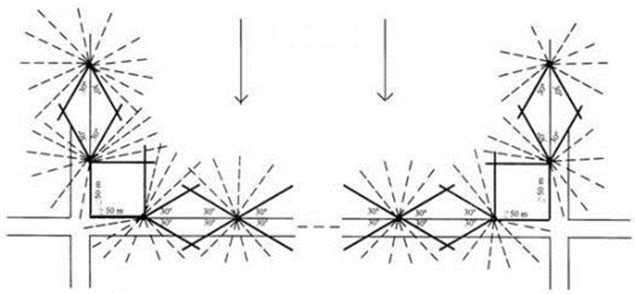
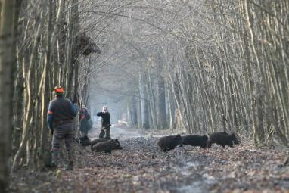


Hunting methods
Driven hunt
Notes:
Pros (efficient) and cons (disturbance and environmental contamination)

Slide 36



Hunting methods
Solo hunt
Notes:
Not disturbant, can be much more selective (e.g targeting females)

Slide 37

Thank you for attention!
Questions?

Slide 38
This presentation is delivered under contract with the Consumers, Health, Agriculture and Food Executive Agency (http://ec.europa.eu/chafea). The content of this presentation is the sole responsibility of Opera S.u.r.l., the Istituto Zooprofilattico Sperimentale Lombardia e Emilia Romagna and the State Food and Veterinary Service of Latvia and it can in no way be taken to reflect the views of the Consumers, Health, Agriculture and Food Executive Agency or any other body of the European Union. The Consumers, Health, Agriculture and Food Executive Agency or any other body of the European Union will not be responsible under any circumstances for the contents of communication items prepared by the contractors.
Opera S.u.r.l.
Viale Parioli 96 - 00197 Roma - Italy
Tel +39 06 96042652 / +39 06 8080111
Fax +39 06 89280678
info@opera-italy.it; www.btsftraining.com;
www.opera-italy.it
European Commission
Consumers, Health, Agriculture and Food Executive Agency
DRB A3/042
L-2920 Luxembourg

