Slide 1

African swine fever in Estonia – development and actions
Andres Lillemäe
Deputy CEO

Slide 2

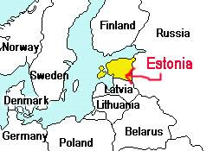

ESTONIA
The area of Estonia is 45,227 m²
The population is 1,3 million people
There are about 15 000 hunters (about 1% of the population), 327 hunting districts and 95 member organizations in Estonia.
We have 51 game species: 19 mammals and 32 birds
hunting year 1. march – last day of february
Hunting bag 2017/18: Elk 7337, red deer 1916, roe deer 15 807, wild boar 7690, brown bear 54, wolf 104, grey seal 9, beaver 7038, fox 5274, racoon dog 6628, marten 3024, golden jackal 26.

Slide 3
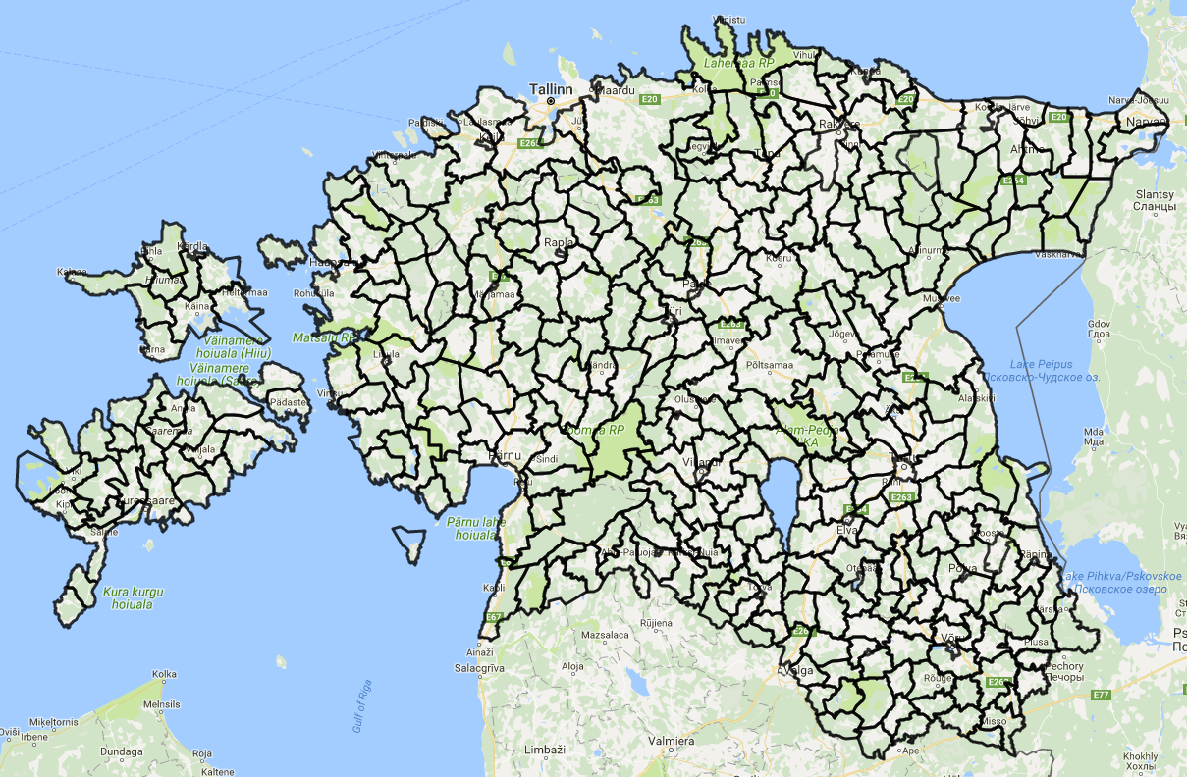
327 hunting districts in Estonia
- Hunting clubs have agreement with state to use hunting district for 10 years.
- The minimal hunting district must be at least 5000 ha
- The average hunting territory is about 12 000 ha

Slide 4
Estonia as a hunting land
Hunting rights for small game belong to the landowner, big game to the hunting clubs.
Hunting is based on the principle of collective hunting.
The owner of the hunting territory has the right to validate the prices of the licenses (for the game).
About 3000-4000 foreign hunters visit Estonia every year.

Slide 5
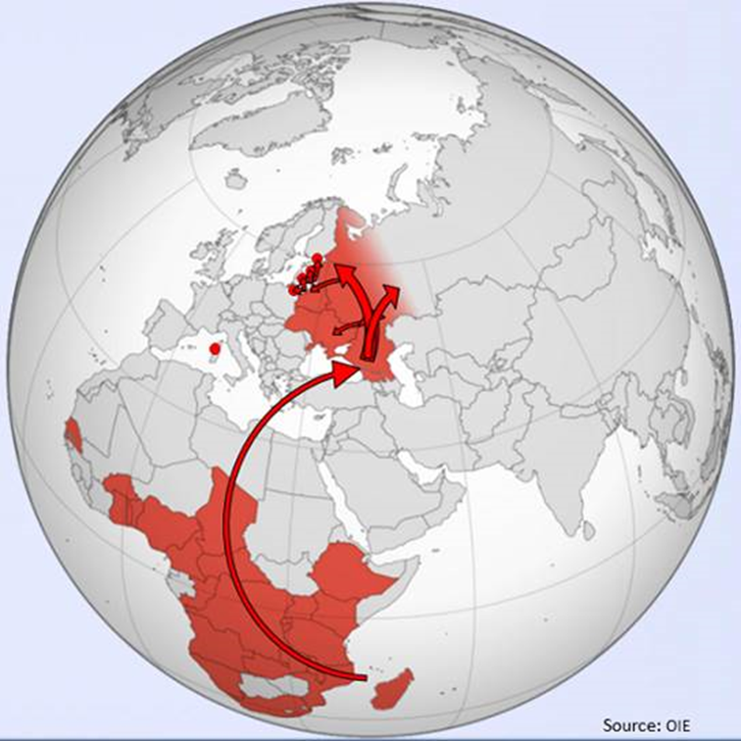
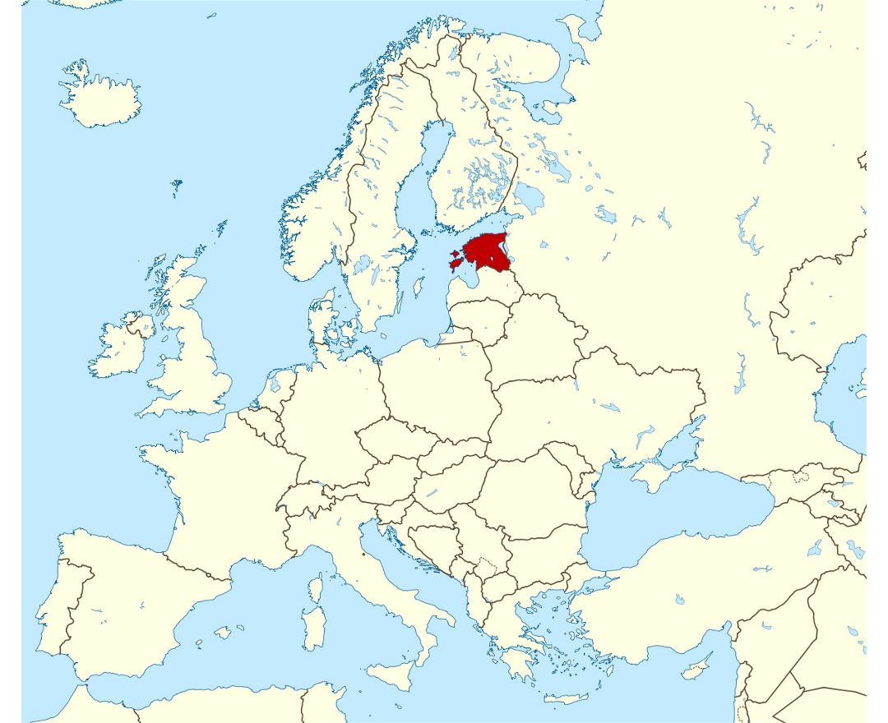
ASF: spread of the virus 8.09.2014 in Estonia

Slide 6
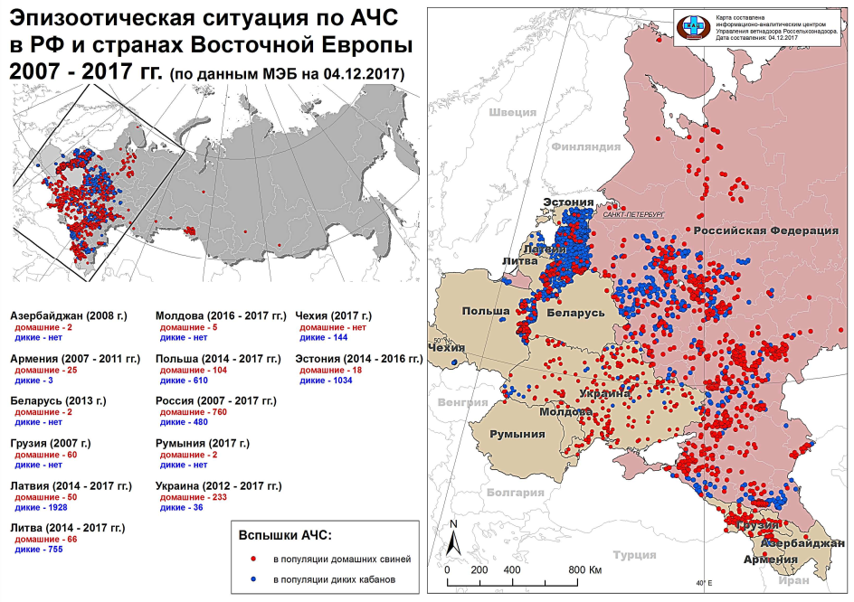
ASF 2007-2017

Slide 7
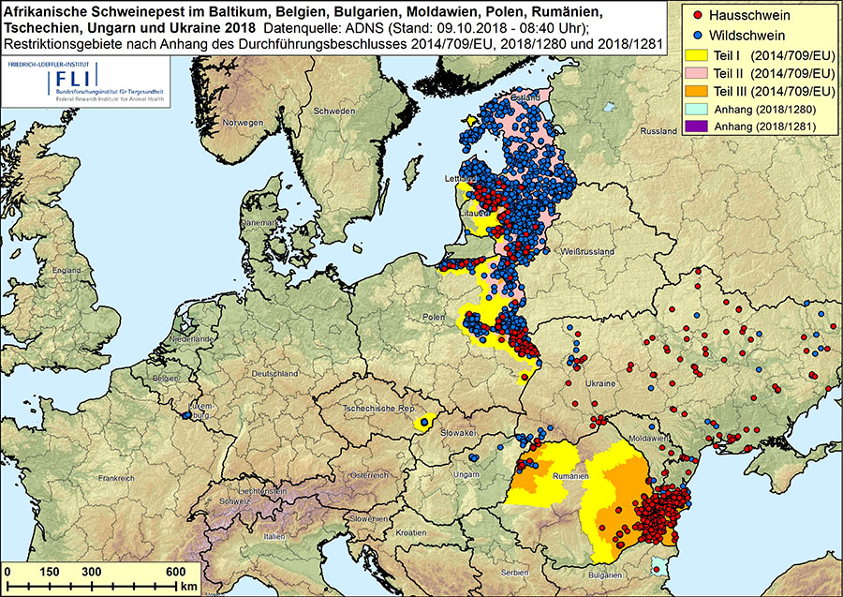
09.10.2018

Slide 8
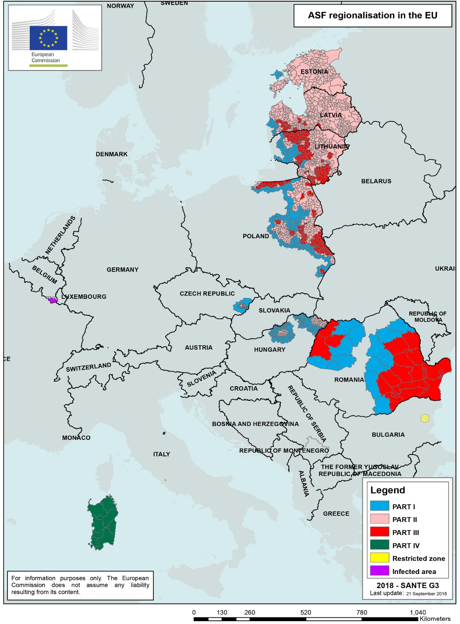
ASF in EU
Sept 2018

Slide 9
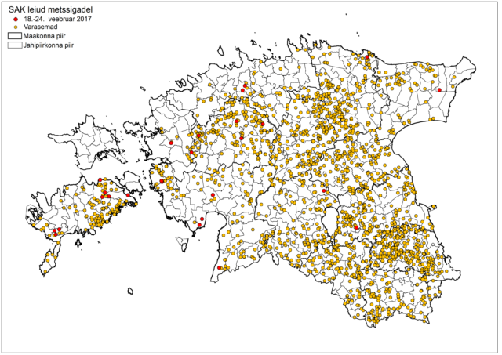
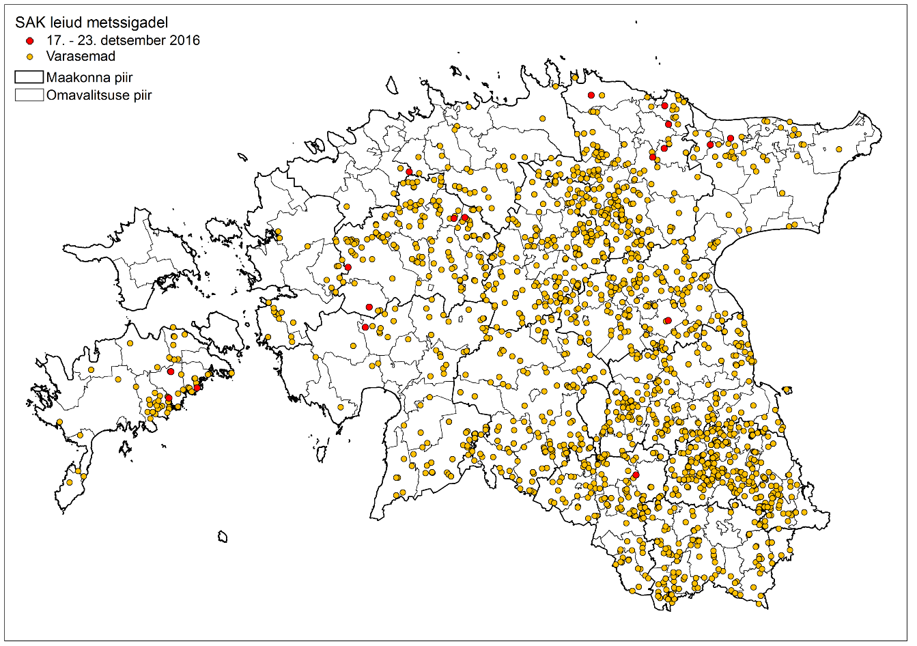
02.2017 12.2017

Slide 10
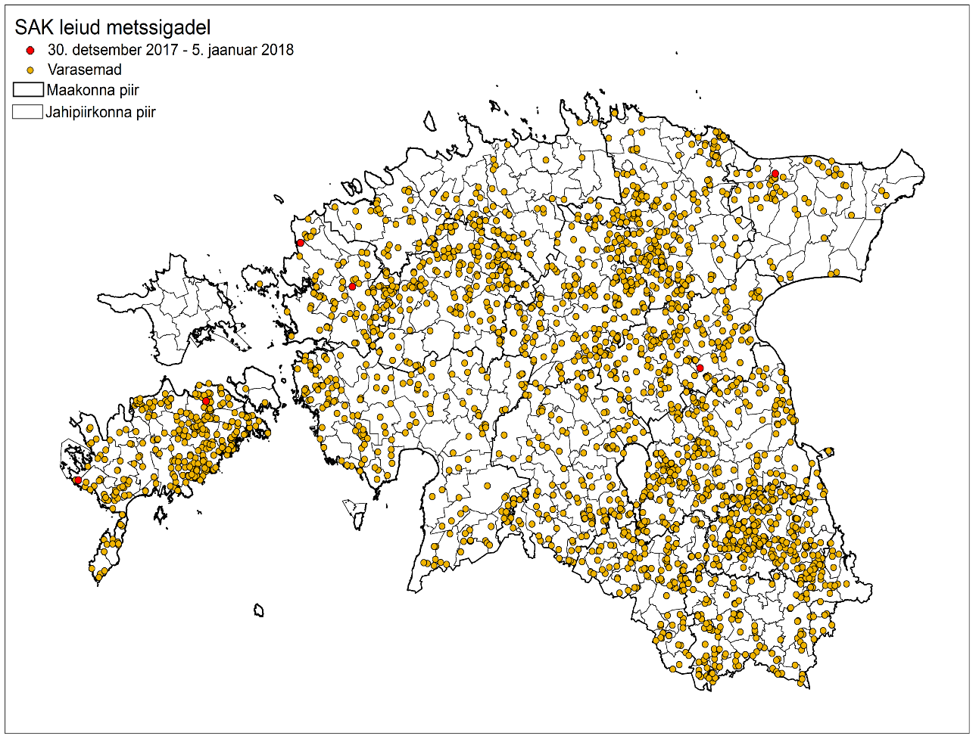
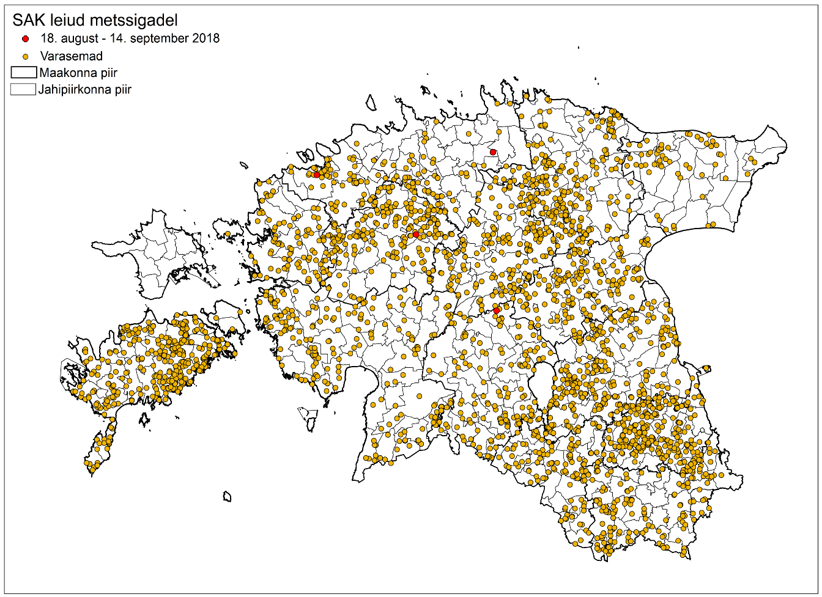
01.2018 09.2018

Slide 11
Dynamics on wild boar numbers
*30.09.2017
Year | Found dead infected | Hunted infected | Sum of positiive samples | Quota from state | Hunting bag | Buried carcasses | executed | total
2014 | 64 | 9 | 73 | - | 24909 | 60 | - | 24969
2015 | 685 | 410 | 1095 | 29608 | 32332 | 2006 | 35 | 34373
2016 | 825 | 743 | 1568 | 18272 | 17415 | 903 | 20 | 18338
2017 | 204* | 284* | 488* | 7557 | 3024* | 199* | 13* | 3236*

Slide 12
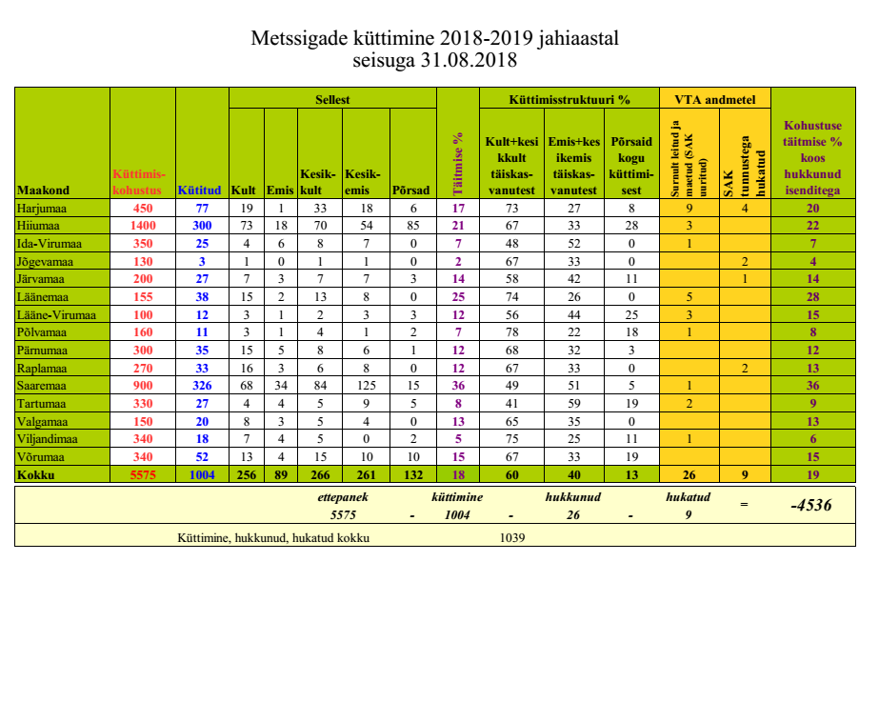

Slide 13
Actions taken to combat ASF
September 2014 ban of driven hunt and hunting with dogs in the infected areas (First strategy in 2014 set the goal not to disturb infected areas)
Ban on hunting with dogs lifted in December 2014 for beaver (with dogs in FCI 3. and 4. group)
Containers distributed for the collection of ASF related carcasses by the state authorities
August 2015 compulsory hunting bag for wild boar (29 100) with the clause that 60% of hunted animals must be female
August 2015 supplementary feeding of wild boar banned (Baiting is still allowed 10 kg maximum on the ground and 100 kg in the feeder. Min distance between baiting stations set to 1 km. Additional feeding allowed during summer to decrease damages to crops.)
August 2015 ban on driven hunts and hunting with dogs lifted (As the fever spread, the strategy changed and was concentrated to bring the population down as quikly as possible).

Slide 14
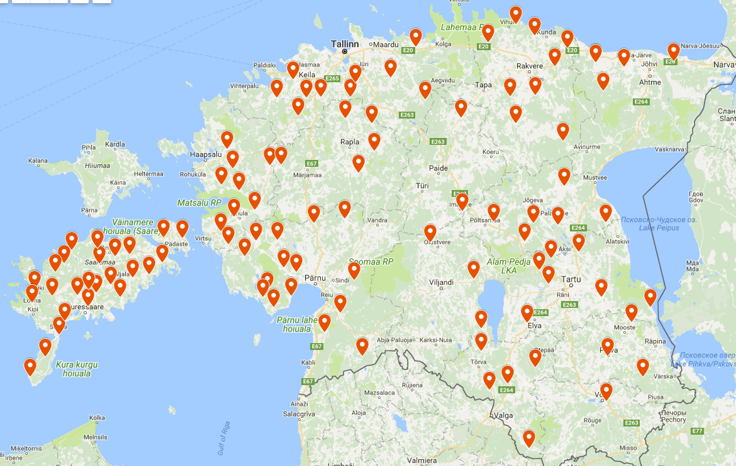
Distributed conteiners for the collection of ASF related carcasses

Slide 15
Actions taken to combat ASF 2.
Goal to decrease wild boar densities to 3 ind/1000 ha by spring 2016
2,5 ind/1000 ha by spring 2017 and 1,5 ind/1000 ha by spring 2018
Driven hunt for wild boar allowed year round
Use of dogs during hunts extended by one month (March)
Shooting of wild boar from vehicles allowed
Use of artificial light allowed for wild boar hunting
Wild boar with ASF symptoms can be shot without permit
Processing of wild boar carcasses is prohibited before the results from the lab are received

Slide 16
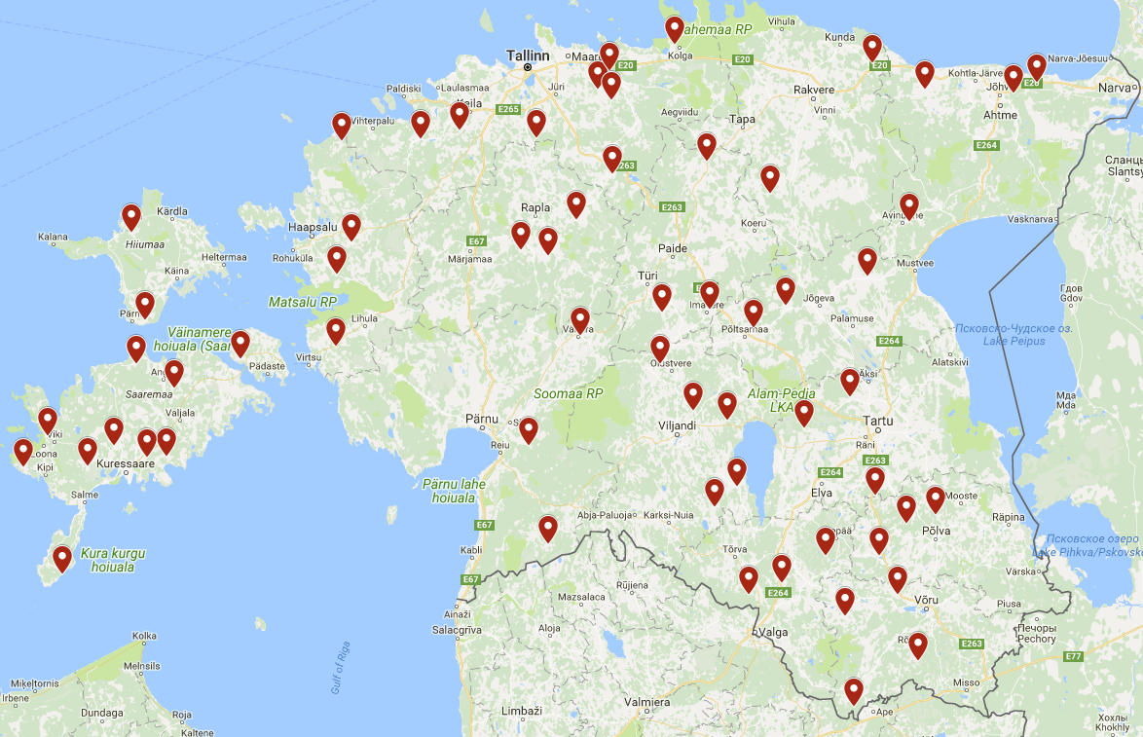
Distributed cold boxes

Slide 17
Actions taken to combat ASF 3.
Fees paid by the Veterinary Service for the disposal on wild boar carcasses and for hunting female wild boar.
70 EUR for each wild boar buried and 35 for each wild boar brought to the collection container and 120 eur for each 1+ year female shot during 2016. Compensations paid for buring due to the large number of dead wild boars found and to keep the hunters motivated on the disposal of the carcasses. Same goes for the compensation for shooting female wild boar. Hunters tend not to shoot large females but when population control is the main goal then shooting females should be the main priority.
2016/2017 hunting bag for wild boar set to 18 272 with the share of females in hunting bag set to 50%
Additional feeding banned with no derogations, baiting allowed but in smaller quantities Baiting allowed but only 5 kg on the ground and maximum of 100 kg per month. One baiting station per 100 ha and min distance between bating stations 1 km. Bating stations must be registered to the Environmental board.

Slide 18
Biosecurity measures - topic no 1
Ground rule: To eradicate the disease, it's neccesary to reduce the virus load in the environment, meaning above all ensuring biosecurity measures throughout the whole process.
Biosecurity measures during hunting. When hunting, it must be taken into account that each hunted and dead hunted wild boar is a risk of infection, and it is therefore very important to ensure biosecurity at every step.
The carcasses of hunted wild boars must be transported so that they do not come into contact with each other.
It is prohibited to remove skin or cut the wild boar into pieces before it has been tested for ASF
Carcasses must be kept/stored separately, each carcase must be identifiable
Careful implementation of biosecurity measures will help reduce the risk of transmission of virus and contribute to its eradication from the environment.

Slide 19
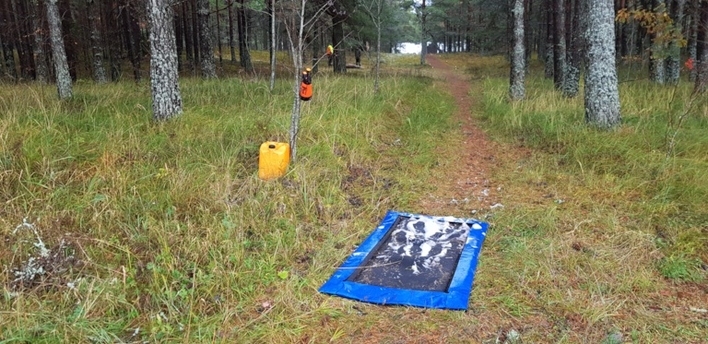
Minimum requirement to handle hunted wild boars
327 hunting districts
All of them are visited and controlled 2017 by Vetservice (film clip)
186 have place for handling of hunted wild boar
136 have cold boxes to keep hunted wild boars over

Slide 20
Action and spread of the virus this year (2018)
Since June we don´t have any III zone areas anymore, since there wasn’t found cases. Majority of the infected areas are in II zone now.
205 boars were found infected this year (data from end of June), 192 of them were bagged, 13 found dead.

Slide 21
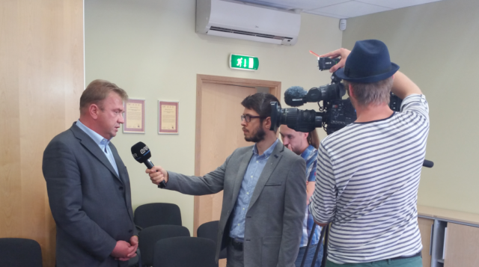
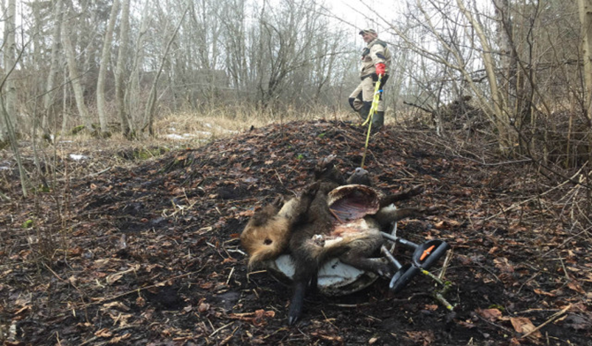
Positions of EHS according to ASF (2014)
Active players
Responsibility (hunting, biosecurity measures)
Cooperation with authorities and information interchange
Partners for the state
Big problem is the extraordinary opportunity. ASF media plan.

Slide 22
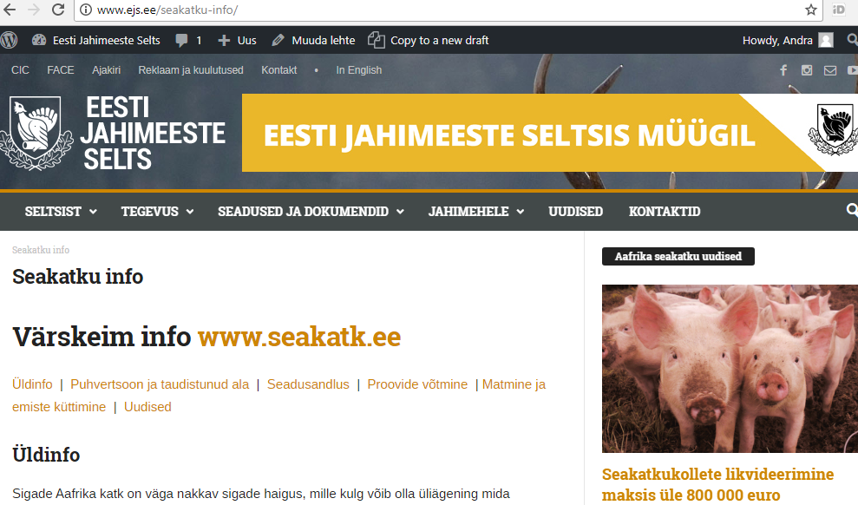

Slide 23
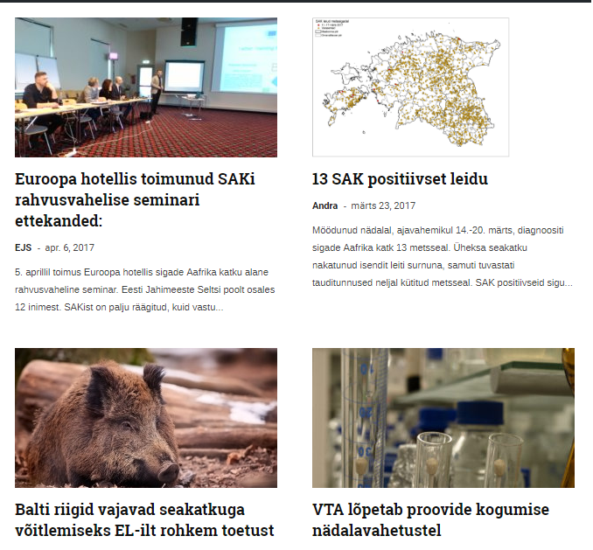
New statics comes every week
Every important news & updates related to the ASF

Slide 24
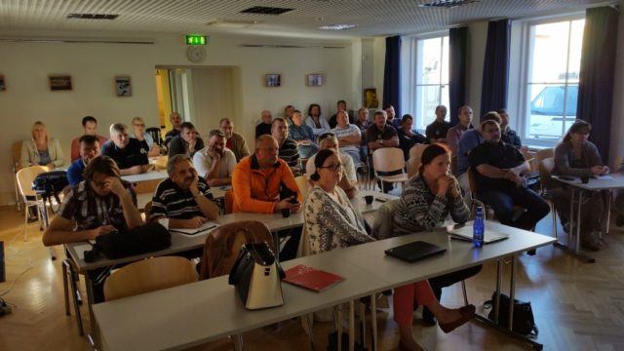
Activities
Awareness raising
Info meetings for hunters and
partners
Agreement with Veterinary and Food Board to put the carcasses to conteiners, to bury carcasses and to hunt females (hunters collect samples for rabies testing).
Infographics, flyers, videoclips

Slide 25
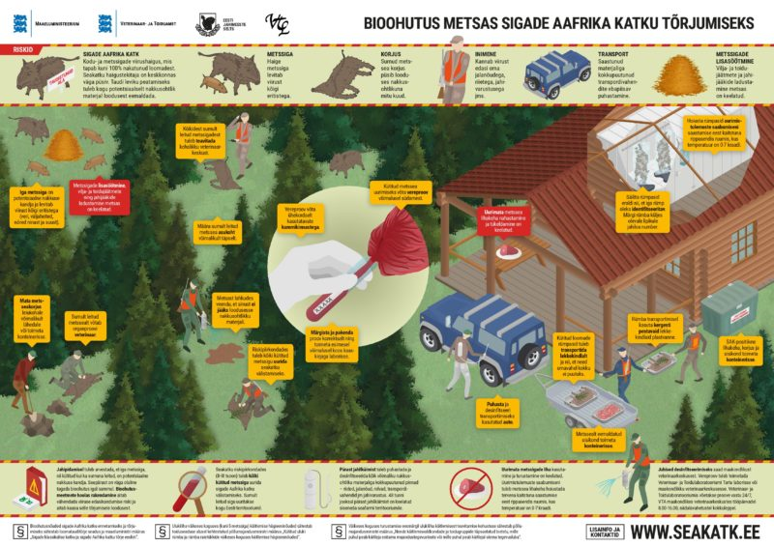
INFOGRAPHICS: BIOSECURITY IN FOREST TO ERADICATE THE AFRICAN SWINE FEVER (ASF)

Slide 26
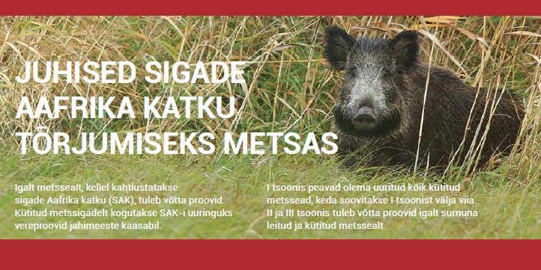
Information for hunters
https://www.youtube.com/watch?v=COZZpqg-OBo&index=3&list=PLk8F-STepltzZuFVdLqNXr35IR8ZbwUpe
https://www.youtube.com/watch?v=1HIe1Lxv8h4

Slide 27
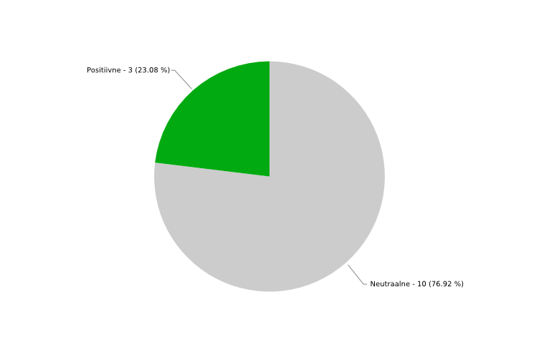
Estonian Hunters Society - emotion or tone of the coverage

Slide 28
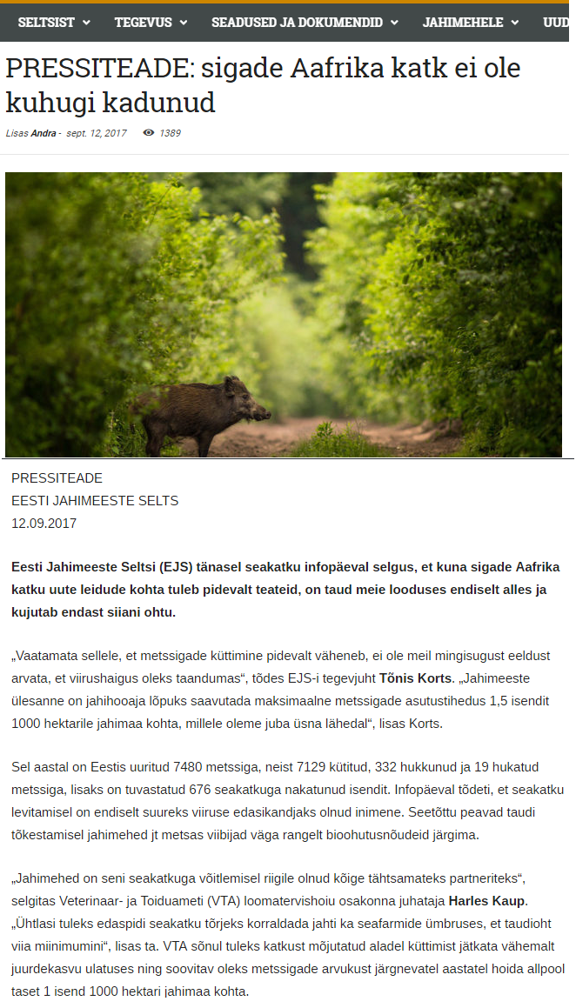
The media role
The situation is stabilised, the media is in a waiting position.
It´s our duty to raise awareness and show our important role in it.
The best way to show our role and importancy in a society.
Press-releases, press-conferences or other events etc.

Slide 29
Our message
Hunters are well-organized part of society and we are ready to take further responsibility.
We wish to be good partners for state down the line.

Slide 30
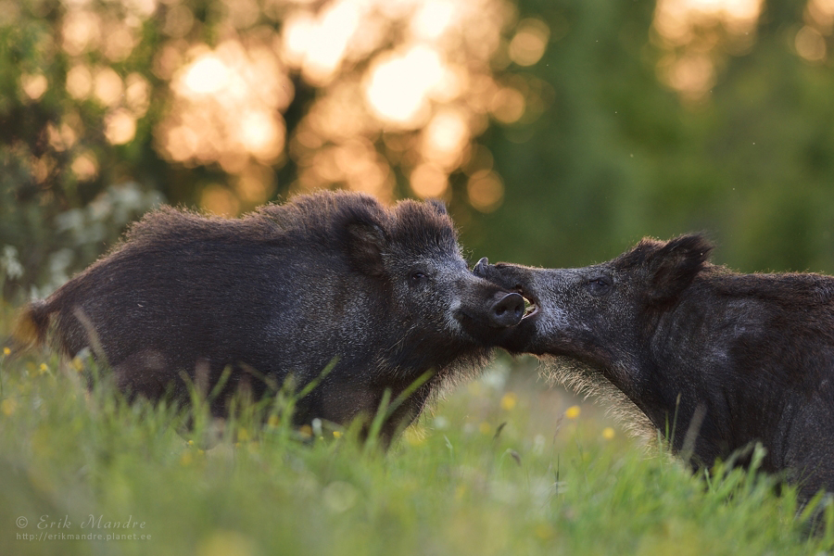
Thank You!
www.ejs.ee

